Slide 1
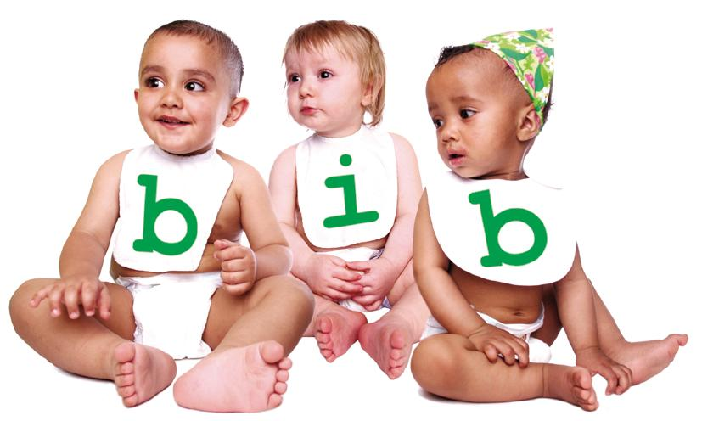


Born in Bradford:
Health, Ethnicity and Inequalities
Notes:
I will give you a quick snippet of information into the Born in Bradford study and Noortje will introduce her research.

Slide 2
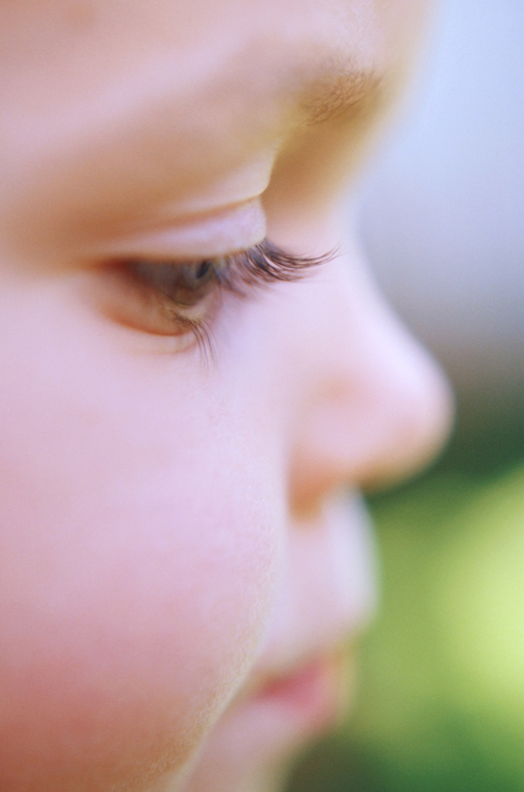
Why Bradford?
  High infant mortality
  High rates of disability
  High rates of asthma
  Impending diabetes epidemic
  Childhood obesity
  Health inequality
Notes:
Bradford has particularly bad health on many outcomes.
Infant Mortality is improving over the past few years but is still amongst the highest in the country
High rates of disability
High rates of asthma and allergies
Life expectancy is 11.9 years lower for men and 7.2 years lower for women in the most deprived areas of Bradford than in the least deprived areas.

Slide 3
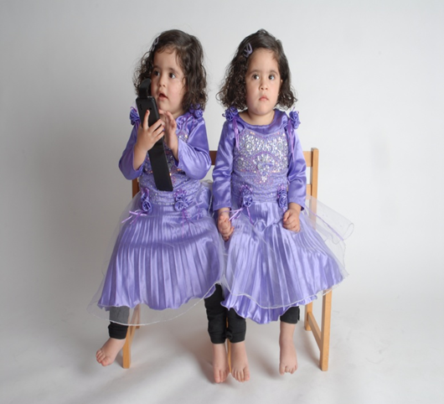
The Born In Bradford Study
  Birth Cohort Study
  13,500 babies since 2006
  Spotlight on Bradford
  Aims to make a difference!
Notes:
Birth Cohort study, following 13,500 babies between 2006-2010.
Interviewed at pregnancy on a whole range of data, data also collected from medial records. Oldest children started school last September, so soon we’ll be able to link up health and education data.
Aims to make a difference
Bringing research into practice, set up a genetic anomalies register, testing for diabetes in pregnancy.
Also more generally, whether putting a spotlight on Bradford, and in particular raising awareness of the health inequalities in Bradford can itself indirectly improve health.
One of the things my research is looking at is whether there’s been a Hawthorne effect, so whether just interviewing mothers has had an effect on their health behavior and furthermore whether this has had any impact on health inequalities – ie. whether mothers higher up the social scale are less likely to change their behaviour than those higher up the social ladder.
That’s a very quick bit of background and I’ll pass you over to Noortje
Hand over to Noortje

Slide 4
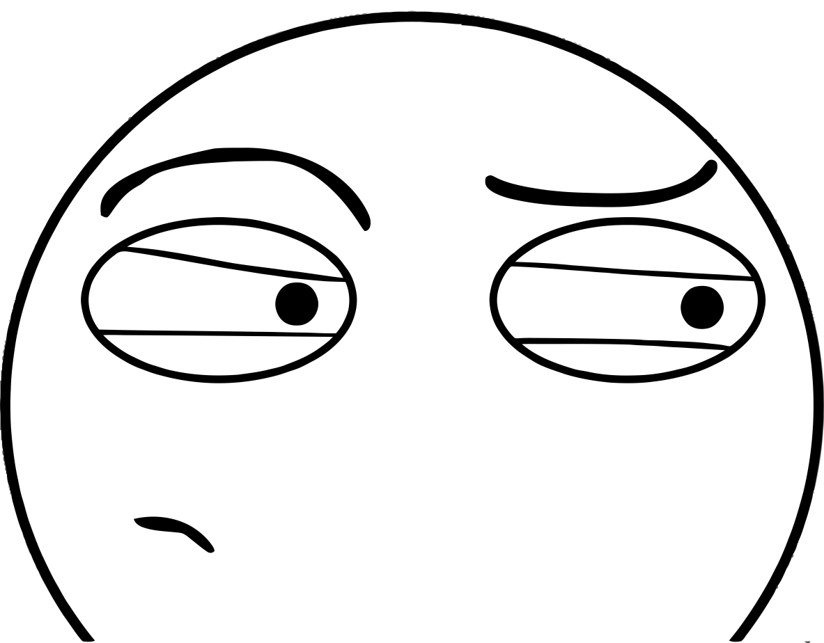
Suspicious minds
Trust among individuals
in an unequal society
Noortje Uphoff, PhD student, University of York, Born in Bradford cohort study

Slide 5
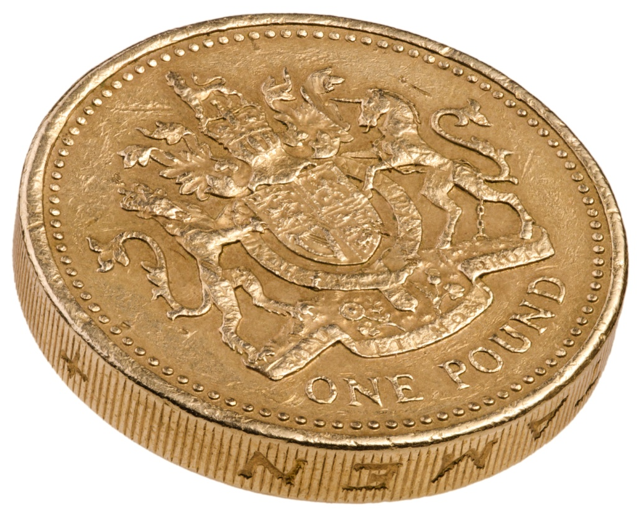
Trust & equality
Eric Uslaner:
The key to trust is
a socially equal society.
Robert Putnam:
Ethnic diversity
(initially) reduces
trust.
Notes:
Uslaner & Putnam, two sides of the same coin? → ethnic diversity predominantly measures whiteness, which in the States is strongly correlated with social inequality.

Slide 6
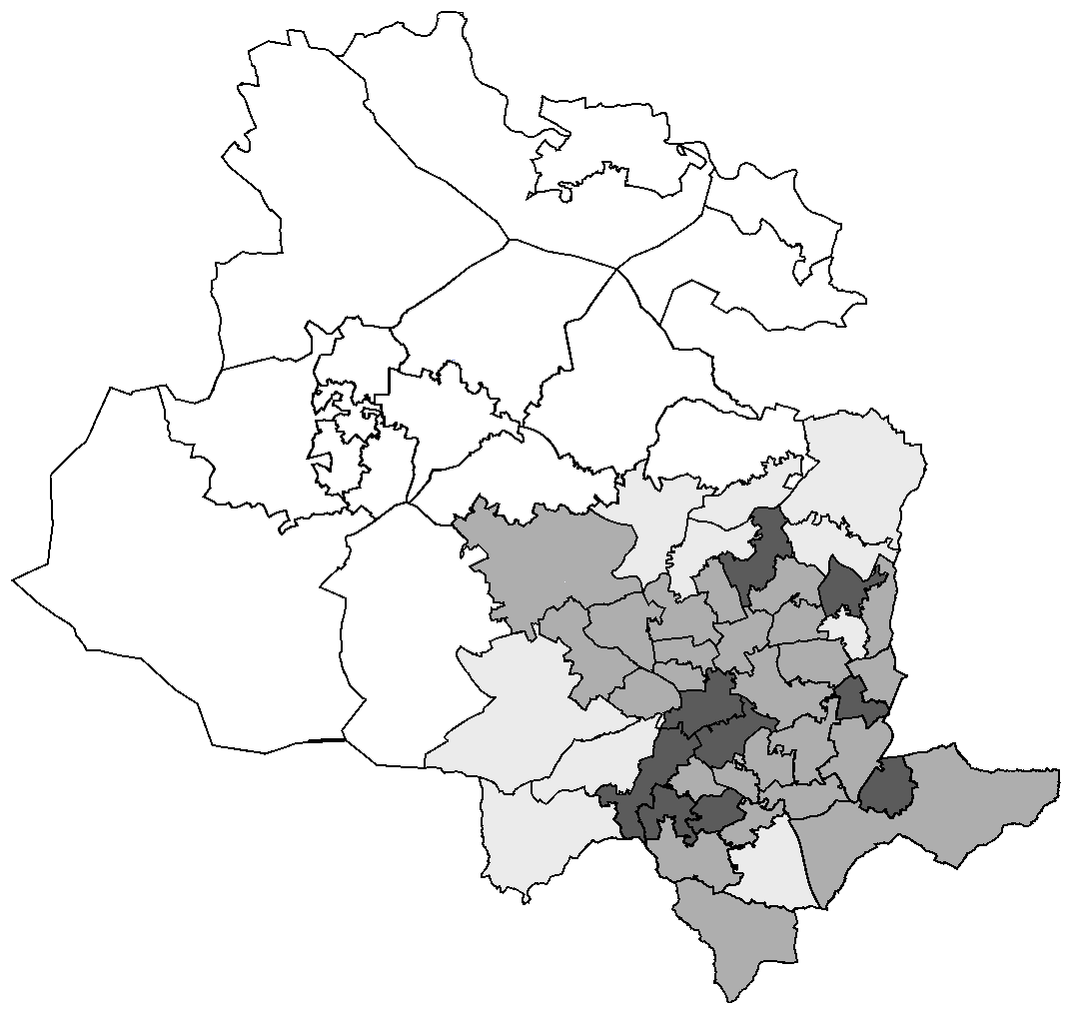
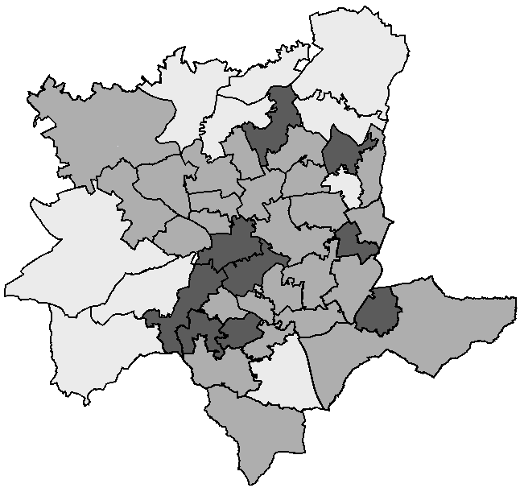
Trust within the population
Holme Wood (4%)
- 81.3% White British
- High levels of deprivation
- Low community cohesion
Where do people trust?
People can be trusted
MSOA level
excluded
< 15%
15-30
> 30%
> 90% White British
- Low levels of deprivation
Manningham (26%)
- 11.7% White British
- High levels of deprivation
Notes:
Individual level: BiB. Average for England: 30% in World Values Survey 2005

Slide 7
Implications
Bottom-up approaches to create healthy, trustful communities are based on the illusion that trust can be build in an unequal society.
Building trust requires starting with the foundation:
social equality.

