Slide 1
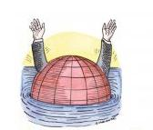
Redefining wealth, redefining progress
26th February 2011, Leeds
Radical Statistics Conference
Viki Johnson
Centre of Interdependence
nef (the new economics foundation)
Notes:
1

Slide 2
About nef
An independent think-and-do-tank founded in 1986
Inspired by 3 principles
Sustainable development
Social justice
People’s wellbeing
‘We aim to improve quality of life by promoting innovative solutions that challenge mainstream thinking on economic, environmental and social issues. We work in partnership and put people and the planet first.’
Notes:
The new economics foundation is an independent think-and-do tank founded in 1986. We are a think and do tank because we bring together a visionary model of research with making things happen in practice.
We work in the UK and internationally on issues as diverse as local economic regeneration, climate change and well-being.
At nef, we aim to explore problems in a systemic way, and develop solutions that focus on the roots causes, rather than simply symptoms. And, whichever way you look at it, most of the problems we face today, stem from a malfunctioning economic system.

Slide 3
Why do we need a new economic direction?
Environment
Society
Economy
Environment
Economy
Neoclassical model of economy
Ecological economics model
Notes:
3

Slide 4
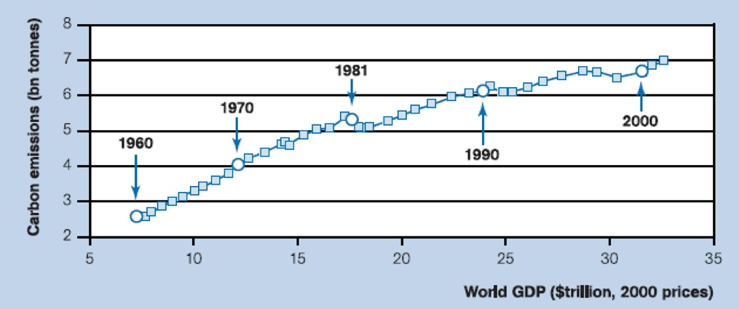
Growth outstrips efficiency gains, even low growth
Year | Change in E/G
1970-1980 | -0.65%
1980-1990 | -0.83%
1990-2000 | - 1.17%
2000-2007 | - 0.40%

Slide 5
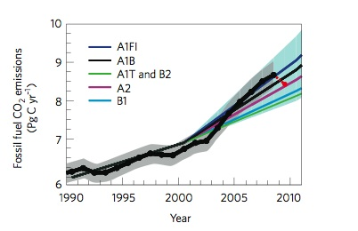
Decoupling? Global growth in CO₂ since the 1990s
Between 2000 and 2008 emissions grew at 3.3 per cent / p.a.
18 ± 15 % of annual growth due to decline in carbon-cycle feedbacks
17 ± 7 % of annual growth due to an INCREASE in carbon intensity of energy
65 ± 16% of annual growth due to an INCREASE in global economic activity
Le Quéré et al (2009)
Notes:
Strong relationship between GDP and carbon means that when the global financial crisis hit in 2008, it had an impact on global CO₂ emissions - and explains most, if not all of the modest growth in emissions of 2% since 2007 compared to the faster average growth of 3.6%/year observed for 2000-2007.
The red DOT is the estimate for global carbon emissions for 2009. Slight slowing in emissions projected for 2009 due to the recession.
The abrupt decrease in GDP in 2009 could bring back global CO₂ emissions back to just below their 2007 level and into the middle range of the emissions scenarios that were used by the IPCC to project this century.
Obviously decrease in growth rate of emissions is good, but the fact that this is more or less simply due to the economic slow down, casts a veil over the fact that the foundations for a low carbon economy simply aren’t being built. For example:
The evolution of emissions after 2009 will depend on subsequent trends in GDP and on the evolution of the carbon intensity of GDP.
Evidence suggests that carbon sinks are beginning to become less effective. Between 1959 to 2008, 43% of each year’s CO₂ emissions remained in the atmosphere on average. The rest was absorbed by land and in the oceans. But in the past 50 years, the fraction of CO₂ emissions that remains in the atmosphere each year has increased, from about 40% to 45%. And models suggest that this trend was caused by a decrease in the uptake of CO₂ by the carbon sinks in response to climate change and variability. Changes in CO₂ sinks are highly uncertain, but they could have a significant influence on future atmospheric CO₂ levels.

Slide 6
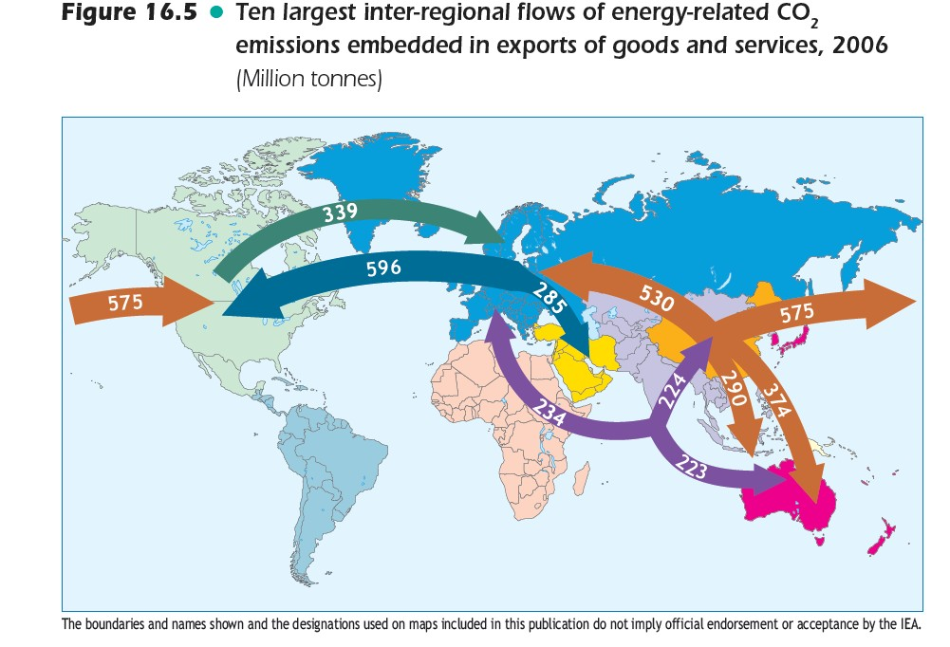
Notes:
With rapid growth in international trade, and a shift in Annex B economic activity towards services were significant in driving non-Annex B CO₂ emission increases due to fossil fuels. In 2001 - 0.22PgC was emitted in non-Annex B countries to produce internationally traded products, consumed in Annex B countries. In China alone, 30% of the growth in emissions between 1990 and 2002 was attributable to the production of exports from China that were consumed in other countries, and the share of the growth increased to 50% between 2002 and 2005.
In 1990, 16% of chinese emissions were from the production of exports, increasing to 30% in 2005. Over half of the exported products were destined for Annex B countries.
Studies of consumption-based monitoring have shown that emisisons including imported products from non-Annex B countries, but excluding goods and services were increasing faster than emissions from domestic production. For example, in the UK - wihtin-country emissions decreased by 5% between 1992 and 2004, whereas consumption based emissions increased by 12%. In the USA, within-country emissions increased by 6% between 1997 and 2004, whilst consumption based emissions increased by 17%.
In both cases, a key factor driving the growth in consumption-based emissions was the import of manufactured products from China.
Explains around 1/4 of growth in non-Annex B emissions since 2000 - notoriously difficult to estimate emissions embedded in trade, and when consider emissions asscoaited with transportation - likely to be an underestimate.

Slide 7
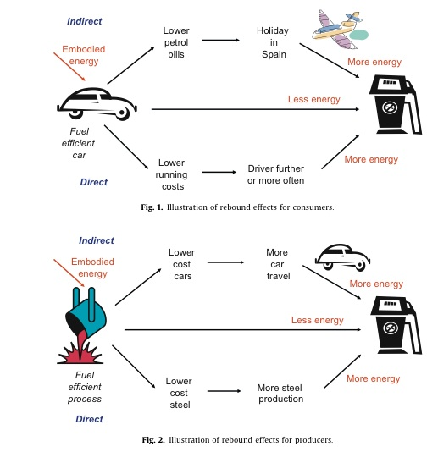
The “inconvenient” rebound effect
Paradox that energy-efficiency improvement leads to more consumption not less.
Consumers
Producers
From: Sorrell, 2009
Notes:
Rebound effect - the paradox that improvements in energy efficiency leads to more consumption not less.
Virtually ignored in climate change policy. Yet transport policy understood very well - in that more roads that are built, the more traffic there is, because cost of travel is reduced (in terms of time), and therefore gains are taken up by an increase in travel and leads to more traffic. Similarly, if roads are closed - traffic miraculously disappears.
Example of how it operates at the consumer/ individual level
Improvements in the fuel efficiency of a car can result in a direct or indirect rebound effect. In the case of the direct rebound effect, with lower running costs, the individual drives further or more often resulting in more energy. For the indirect rebound effect, the savings made from lower petrol costs are used to take an overseas holiday.
Example of how it operates on the supply side.
For producers, the process is similar. In the direct case - on the bottom, as the manufacturing process becomes more fuel efficient, it reduces the cost of materials such as steel. This leads to more steel production. An indirect rebound effect - see the top line of the second diagram, shows that a more fuel efficeincy process leads to a fall in the cost of cars, this increasing either car ownership or travel. Again, bit lead to more energy.

Slide 8
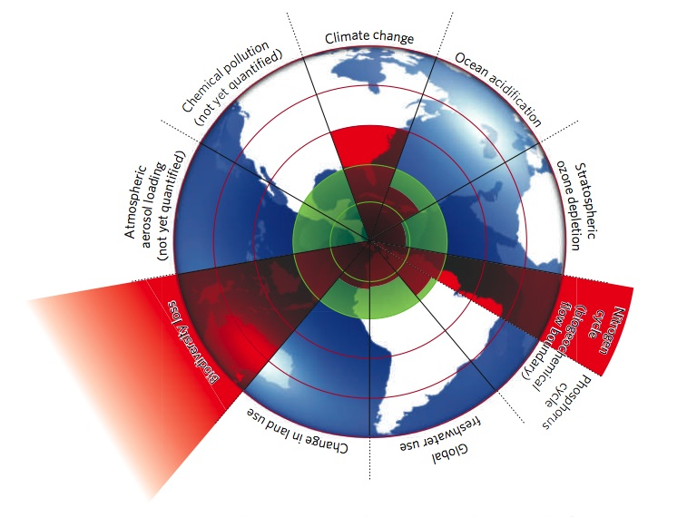
Not just carbon: planetary boundaries
Rockström et al., 2009

Slide 9
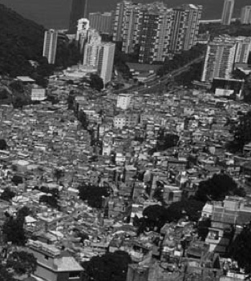
What’s it all for?
Growth isn’t working
Between 1990 - 2001
For every $100 worth of growth in the world’s per capita income, $0.60 found its target and contributed to reducing poverty below the $1-a-day line.
To achieve a single dollar of poverty reduction for people living below $1-a-day, $166 of extra global production and consumption was needed compared to around $45 the previous decade
And, need 15 planet’s of resources to get there using this model…

Slide 10
Rising inequalities
1984 to1999: Global GNP grew 40% while the number of poor grew by 17%.
More than 100 countries became worse off in this period.
People in richest 20% vs poorest 20% of countries:
30 times better off in 1984;
61 times better off in 1996;
82 times better off in 1998.
The world's 225 richest people had a combined wealth ($1 trillion) equal to the combined annual income of the world's 2.5 billion poorest people
The wealth of the three most well-to-do individuals now exceeds the combined GDP of the 48 least developed countries.

Slide 11
The Great Transition
Revaluing: making social and environmental value central to decision-making
Redistribution: more equal societies are happier
Rebalancing: rebalancing of the market sphere alongside the public sphere and ‘core economy’
Relocalisation: subsidiarity and redefining efficiency
Reskilling: from consumers to producers
Economic Irrigation: using finance to facilitate the change
Interdependence: global emissions cap, transfer of funds for ‘climate proof and climate friendly’ development.
Notes:
THE OPPORTUNITY
Which identify although there are resources flowing into and out of those communities – they are not effectively used
Need to shape environments to fit human needs within the resource constraints of the biosphere – need rapid transition models.
We need to reassess resource efficiency in terms of delivery of delivering happy life years (life satisfaction over life expectancy)
Resilience is the goal not growth.
Experiment & innovate – which is at the heart of adaptation

Slide 12
Redefining wealth is central to the Great Transition
We want good lives now and good lives in the future
There is a perceived trade off between these goals –which is why sustainability is political
In our view, measures of sustainability are part of a set of measures designed to help manage the trade off
The Happy Planet Index (‘HPI’) was a first stab
life expectancy times life satisfaction (‘happy life years’) measures good lives now
ecological footprint is a proxy for good lives in the future
The current work on measuring progress by the UK Office of National Statistics (ONS) could advance this

Slide 13
If GDP is a proxy for good lives now the trade off is acute

Slide 14
But Happy Life Years are a better proxy – and the trade off is less acute

Slide 15
The results can be expressed as a league table…
HPI rank | Countries | Region | Life Sat | Life Exp | EF |  | HPI
1 | Costa Rica | 1a | 8.5 | 78.5 | 2.3 | = | 76.1
2 | Dominican Rep | 1a | 7.6 | 71.5 | 1.5 | = | 71.8
3 | Jamaica | 1a | 6.7 | 72.2 | 1.1 | = | 70.1
9 | Brazil | 1b | 7.6 | 71.7 | 2.4 | = | 61.0
20 | China | 6a | 6.7 | 72.5 | 2.1 | = | 57.1
35 | India | 5a | 5.5 | 63.7 | 0.9 | = | 53.0
43 | Netherlands | 2c | 7.7 | 79.2 | 4.4 | = | 50.6
74 | UK | 2c | 7.4 | 79.0 | 5.3 | = | 43.3
114 | USA | 2b | 7.9 | 77.9 | 9.4 | = | 30.7
143 | Zimbabwe | 4a | 2.8 | 40.9 | 1.1 | = | 16.6
Notes:
15

Slide 16
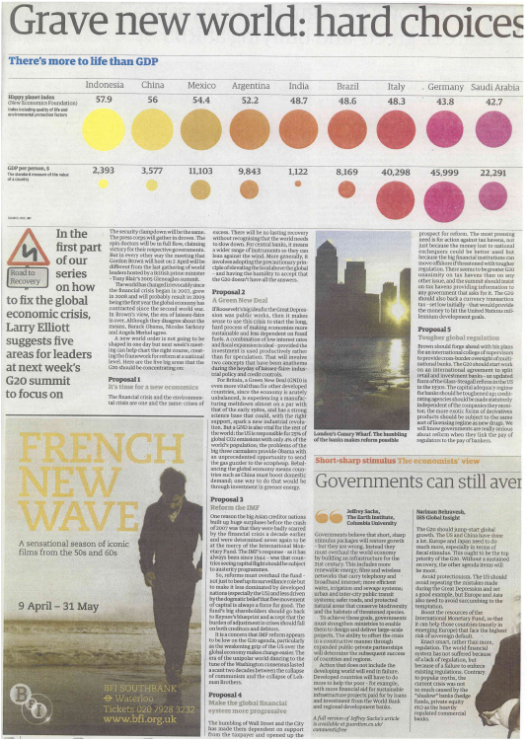
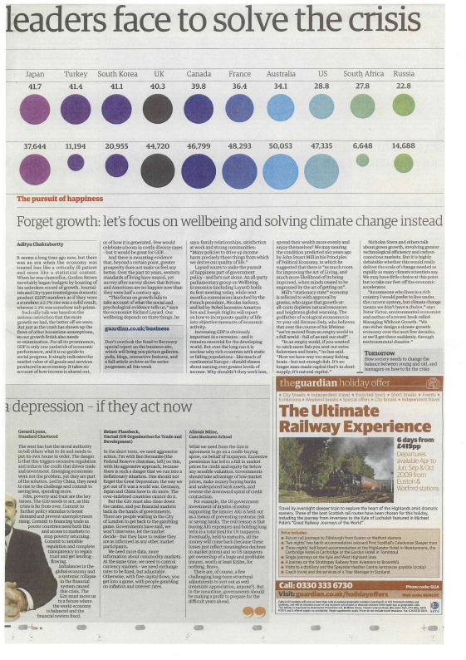
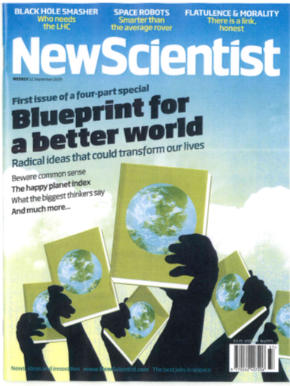
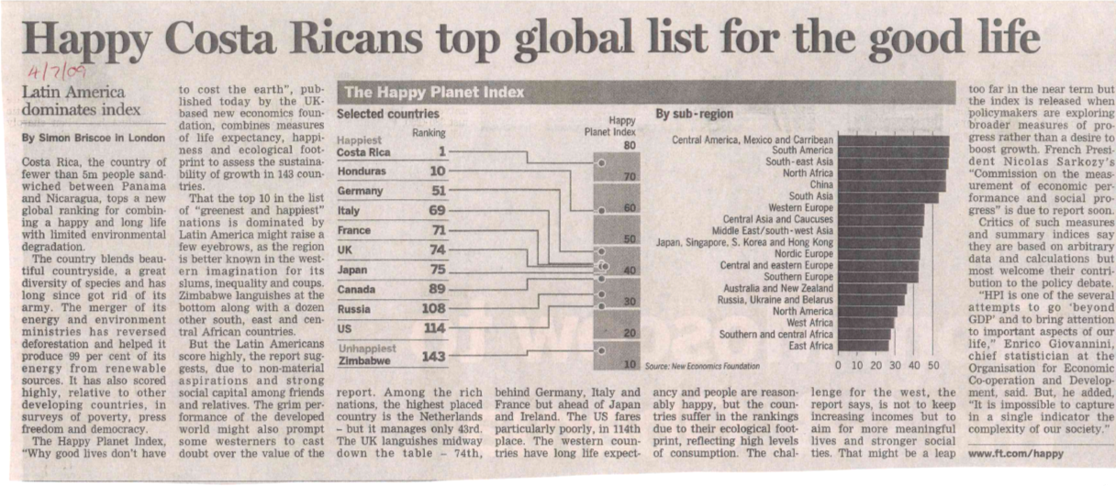
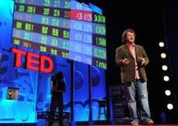
…which has attracted a lot of attention
The HPI was launched in July 2006 and within two days the report was downloaded and read in 185 countries worldwide.
The HPI 2.0 website was launched in July 2009 and in the first week received 87,500 visitors. Since then almost half a million people have visited the site .
Press coverage and public interest was very high, and has been continuing since then...
Notes:
16

Slide 17
The opportunity now is to move from attention to policy
UK politicians and civil servants are receptive…
“We have to recognise officially, that economic growth is a means to an end” Prime Minister David Cameron November 2010
We need “measurements that rival GDP in importance” David Willets, UK Minister for Universities, February 2011
“Next time we have a spending review, let’s not just guess what effect various policies will have on people’s well-being. Let’s actually know” Senior UK Civil Servant November 2010
…and have backed the UK ONS project to develop new measures of well-being and national progress
These should help aim at good lives now (‘well-being’)...
…and manage the trade off with good lives in the future
Hence our advice…
Notes:
17
Anecdote of NW strategy.
Describe as a ‘winner takes all’ situation with indicators. Say this is worth combating in its own right, but given it exists, we need to make sure there is a strong alternative for a headline indicator.

Slide 18
We can start to build a framework for the measures
Good lives in the future
Environ-mental resources
Good lives now
Human
Systems
systems-resource
efficiency
goals-systems
efficiency
We should measure systems which impact on lives
Environmental resources are a proxy for the future
Relationships between spheres measure efficiency
Our focus is on good lives now and its causes

Slide 19
So how should we measure good lives now?
Measures need to be valid
They must actually measure whether people are having good lives reasonably accurately
Measures need to be usable
They must be linked to alternative policy outcomes so that policy-makers can use the measures to develop policy
Measures need to be political
They must resonate with the media and voters and so create pressure on politicians to use the measures to set policy objectives
Notes:
19
Anecdote of NW strategy.
Describe as a ‘winner takes all’ situation with indicators. Say this is worth combating in its own right, but given it exists, we need to make sure there is a strong alternative for a headline indicator.

Slide 20
Happy Life Years is quite valid and usable…
Life quality measured entirely by the question ‘how satisfied are you with your life as a whole these days?’
One question subject to measurement error
different groups have different norms against which they judge
difficult to recall full variety of life in response to one question
There is more to a good life than satisfaction
Does not provide any clues as to why particular policy outcomes are good/bad
A richer measure is desirable – and possible…
Notes:
20
Anecdote of NW strategy.
Describe as a ‘winner takes all’ situation with indicators. Say this is worth combating in its own right, but given it exists, we need to make sure there is a strong alternative for a headline indicator.

Slide 21
It is a measure of flourishing – which draws on Aristotelian and utilitarian accounts of the good life
Good feelings
day-to-day and overall
e.g. happiness, joy, contentment, satisfaction
good life now
Good functioning and satisfaction of needs e.g. to be autonomous, competent, safe and secure, connected to others
External
Conditions
e.g. material conditions, work and productivity, income (levels and stability)
Personal
Resources
e.g. health, resilience, optimism, self-esteem,
Adapted from Foresight (2008)

Slide 22
Flourishing is best measured subjectively
Overall on a scale of 0-10, how satisfied are you with life nowadays?
How much of the time yesterday did you feel happy?
Most days I feel a sense of accomplishment from what I do (agree – disagree)
How satisfied are you with your present standard of living?
Taking all things together, how happy would you say you are?
In my daily life I get very little chance to show how capable I am (agree – disagree)
To what extent do you feel that you get the recognition you deserve for what you do?
I generally feel that what I do in my life is valuable and worthwhile (agree – disagree)
I feel I am free to decide how to live my life (agree – disagree)
In my daily life, I seldom have time to do the things I really enjoy (agree – disagree)
How much of the time during the past week have you felt bored?
How much of the time during the past week have you been absorbed in what you were doing?
To what extent do you get a chance to learn new things?
To what extent do you feel that people treat you with respect?
Most people can be trusted, or you can’t be too careful?
How much of the time yesterday did you feel lonely?
There are people in my life who really care about me (agree – disagree)
How much of the time spent with your immediate family is enjoyable?
How often do you meet socially with friends, relatives or colleagues?
How satisfied are you with how your life has turned out so far?
How much of the time during the past week have you enjoyed life?
How much of the time during the past week have you felt sad?
Do you have anyone with whom you can discuss intimate and personal matters?
How much of the time during the past week have you felt depressed?
On the whole my life is close to how I would like it to be (agree – disagree)
To what extent do you feel that people in your local area help one another?
To what extent do you feel that people treat you unfairly?
How much of the time spent with your immediate family is stressful?
I feel I have little control over important things in my life (agree – disagree)
Satisfying life
Emotional well-being
Competence
Meaning and purpose
Autonomy
Engagement
Trust and belonging
Supportive relationships
Good feelings
day-to-day and overall
e.g. happiness, joy, contentment, satisfaction
Good functioning and satisfaction of needs e.g. to be autonomous, competent, safe and secure, connected to others

Slide 23
We are recommending five questions to the ONS
Overall on a scale of 0-10, how satisfied are you with life nowadays?
How much of the time yesterday did you feel happy?
Most days I feel a sense of accomplishment from what I do (agree – disagree)
How satisfied are you with your present standard of living?
Taking all things together, how happy would you say you are?
In my daily life I get very little chance to show how capable I am (agree – disagree)
To what extent do you feel that you get the recognition you deserve for what you do?
I generally feel that what I do in my life is valuable and worthwhile (agree – disagree)
I feel I am free to decide how to live my life (agree – disagree)
In my daily life, I seldom have time to do the things I really enjoy (agree – disagree)
How much of the time during the past week have you felt bored?
How much of the time during the past week have you been absorbed in what you were doing?
To what extent do you get a chance to learn new things?
To what extent do you feel that people treat you with respect?
Most people can be trusted, or you can’t be too careful?
How much of the time yesterday did you feel lonely?
There are people in my life who really care about me (agree – disagree)
How much of the time spent with your immediate family is enjoyable?
How often do you meet socially with friends, relatives or colleagues?
How satisfied are you with how your life has turned out so far?
How much of the time during the past week have you enjoyed life?
How much of the time during the past week have you felt sad?
Do you have anyone with whom you can discuss intimate and personal matters?
How much of the time during the past week have you felt depressed?
On the whole my life is close to how I would like it to be (agree – disagree)
To what extent do you feel that people in your local area help one another?
To what extent do you feel that people treat you unfairly?
How much of the time spent with your immediate family is stressful?
I feel I have little control over important things in my life (agree – disagree)
Overall on a scale of 0-10, how satisfied are you with life nowadays?
Satisfying life
Emotional well-being
Competence
Meaning and purpose
Autonomy
Engagement
Trust and belonging
Supportive relationships
Good feelings
day-to-day and overall
e.g. happiness, joy, contentment, satisfaction
How much of the time yesterday did you feel happy?
I generally feel that what I do in my life is valuable and worthwhile (agree – disagree)
I feel I have little control over important things in my life (agree – disagree)
Good functioning and satisfaction of needs e.g. to be autonomous, competent, safe and secure, connected to others
How much of the time yesterday did you feel lonely?

Slide 24
These can form the basis for policy decisions…
Large surveys (450,000 pa) will reveal statistical relationships with conditions policy can influence
This will help identify priorities…
Reorder existing priorities/trade offs – eg unemployment, working hours, alternative transport modes
Bring to light groups whose well-being is low – eg young people in particular locations or occupations
Identify impact of widespread problems – eg sleep disorder
…and provide a common currency for policy evaluation
Well-being impact assessment can replace GDP impact assessment (before and after implementation)
Heuristics to guide detailed policy design can be developed
Notes:
24

Slide 25
…but only if the measures also influence politicians
The measures must resonate with the media and voters
Consider how inflation and unemployment rates do this:
Measures of things that matter
Politicians can be praised or blamed for them
Measures of things that seem public – reflect shared experiences that can be talked about (although what is private and what public changes over time)
They are the basis for comparisons – year on year change, other countries, different regions
We need headline measures that will deliver these things
And we need to encourage NGOs, journalists, opposition politicians to use these to hold government to account
Notes:
25

Slide 26
Hence our main recommendations
A headline index, initially based on the five questions, which reports the percentage of people flourishing
This is about something that matters to people
The percentage above a threshold will vary more year on year than an average figure
An indicator of well-being inequality
This also matters to people – and counters the fear that minority experiences could be under reported in the headline index
A set of objective indicators measuring the statistically established Drivers of Well-being (DoW)
This anchors the measure to those things politicians are currently praised or blamed for, and are the basis for shared experiences
Notes:
26

Slide 27
So in terms of the framework set out earlier
Environ-mental resources
Good lives now
Index of Flourishing, Inequality measure
Human
Systems
DoW
DoW, Modified GDP
Environmental resources are part of the framework
To measure environmental efficiency may require modified GDP alongside DoW

Slide 28
Next steps
Detailed design of measures
International convergence

Slide 29
Find out more
www.neweconomics.org
victoria.johnson@neweconomics.org
Notes:
29

