Slide 1
The legacy of Rowntree Jonathan Bradshaw
Yorkshire Philosophical Society Lecture
Radical Statistics Society
Priory St
York
23 February 2013

Slide 2
Outline
Legacy of Seebohm Rowntree
1899 study
Impact on policy, ideas and social science
Relevance today
Is York typical on poverty and inequality
No but….
Limited local data on poverty and inequality

Slide 3
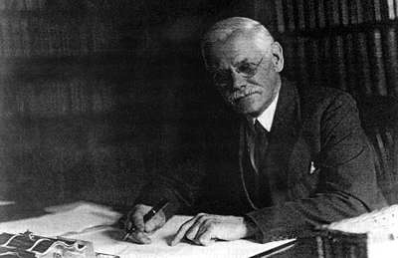
Benjamin Seebohm Rowntree

Slide 4
B. Seebohm Rowntree
Poverty: A Study of Town Life 1901
The man: son of Joseph, Quaker, Liberal, 28. Manchester University food chemist. Motivated by Booth
Survey 1899, all 46,754 people in 11,560 working class households in York, short Q, no income schedule, one investigator!
Concepts:
Poverty threshold = minimum necessities for the maintenance of merely physical efficiency
Primary (9.9%) and Secondary poverty (17.9%)
Findings
Cause of primary poverty: low wages (52%), large families (22%), death of breadwinner (16%), incapacity (5%), un/under employmnent 5%)
Life cycle of poverty

Slide 5
Impact of Rowntree
First social science – beyond description?
Impact on research and social science – British empirical tradition
Excellent presentation – writing, tables, charts, maps, case studies. Chapters on housing, health – spatial analysis of heights and weights, education.
Humane – primary poverty line used as an heuristic device (JVW)
Poverty not the fault of the poor, no distinction between the deserving and undeserving – direct assault on ideology of the Poor Law and COS
No recommendations - something must be done
Impact on Lloyd George and Winston Churchill ‘I have been reading a book which has fairly made my hair stand on end… 1902 Liverpool’
Possible impact on Webbs’ Minority Report
Liberal Government reforms
1936 study impact on Beveridge
1955 eradication of poverty myth.

Slide 6
Relevance today
JRF and Trusts. Major York landlord/ social care provider. Research funder – poverty/place/ageing
York: Fairness Commission – Living Wage
Still studying poverty in similar ways – thresholds, budget standards, household surveys, modes of presentation.
Analysis – prevalence, causal explanations, consequences
Stark contrast to
Consultation on child poverty measurement
IDS poverty=drugs, improvidence, 120,000 problem families
RH Tawney 'Improve the character of individuals by all means - if you feel competent to do so, especially of those whose excessive incomes expose them to particular temptations' ('Poverty as an Industrial Problem', Inaugural lecture as Director of the Ratan Tata Foundation, LSE, 1913).
Low wages, children, inadequate/non existent social benefits
Many advances in
Concepts: Relative, income, resources, rates and gaps
Method: Sampling, equivalence, deprivation, persistence

Slide 7
York: ? A social science lab
‘Having satisfied myself that the conditions of life obtaining in my native city of York were not exceptional, and that it might be taken as fairly representative of the conditions existing in many of not most of our provincial towns’
No survey of poverty in York after 1955.
Some follow up studies of descendants (Atkinson, Maynard, Trinder, Carr Hill)
Huby et al (1999) review of evidence on living standards “At the end of the 1990s, York might still be regarded as ‘fairly representative’ of a provincial town.” (p 1).
York Fairness Commission evidence
2011 census
York is growing 9.4%, 20-24. 85+
York looks unusually monochrome in terms of ethnicity (but Gary Craig). Census 2011 8.8% not white British 5.5% born outside EU.
Students (poverty). Recently the local media were surprised to learn from the ONS that York has one of the lowest fertility rates of any local authority in England.
Highly qualified 13th nationally.
Nothing notable on family structure etc

Slide 8
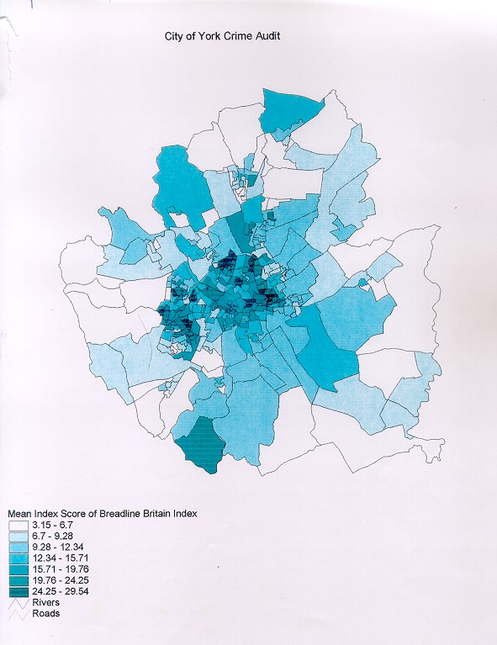
Census 2001: Breadline Britain Index
Census – Townsend Poverty index

Slide 9
York: index of deprivation quintile distribution of LSOAs 2010

Slide 10
York: Changes in LSOA ranks 2007-2010

Slide 11
York: Child well-being decile distribution LSOAs

Slide 12
York now probably not typical BUT
Credit Union closed - Food Bank open
Every loan shark has a high st. presence
Dreaded ATOS ESA assessments. Welfare Benefits Unit appeals representation won £1million in five years. £330,000 in unclaimed DLA for children in a year
Still a low wage city – Living Wage evaluation
House prices
17,600 (4,800 out of work) children on child tax credits excluding Family Element
24,400 (29%) households receiving means-tested benefits/tax credits in early 2012
Most non pensioner poor start paying 20% Council Tax next month.

Slide 13
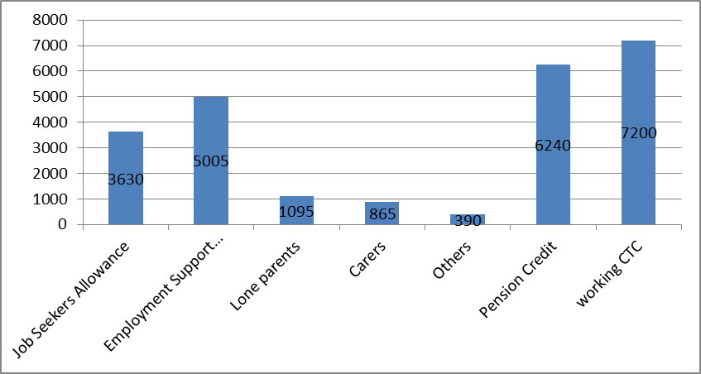
York households (benefit units) receiving means-tested benefits February 2012

Slide 14
York data on poverty and inequality?
Is there a gap in local data on poverty and inequality?
York Fairness Commission http://www.yorkfairnesscommission.org.uk/assets/files/PDF/Findings%20and%20recommendations.pdf
York Child Poverty Needs Assessment
http://www.yor-ok.org.uk/Downloads/Child-Poverty/Child%20Poverty%20Needs%20Assessment%20Update%20November%202012.pdf
Lots of spatial data.
Individual/household?
One final indicator
My net income before retirement= £872 per week
Lone parent plus one child on Income Support= £133 per week

