Slide 1
Death By Numbers
Cholera, Fever and Statistics in Victorian Liverpool

Slide 2
Impact of John Snow
Investigation to response to cholera outbreaks in Liverpool
Did they listen to the work of Snow?
Cholera outbreak in 1866

Slide 3
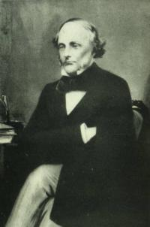
Dr William Duncan
Medical Officer of Health

Slide 4
Report on the Physical Causes of High Mortality Rate - 1843
Statistical Analysis of Locations and Ages of Death
Proves that Liverpool is the most unhealthy city in England and Wales
Describes appalling housing conditions, lack of drains and sewers, over-crowding
Correlation in statistics prove that these are the cause of high mortality and epidemic typhus
Shows link to bad air by showing that open courts were better than closed ones

Slide 5
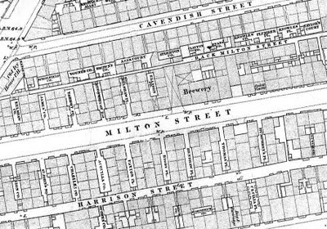

Slide 6
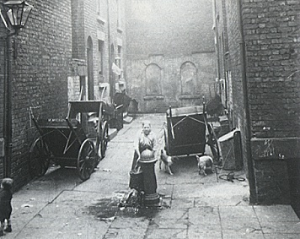

Slide 7
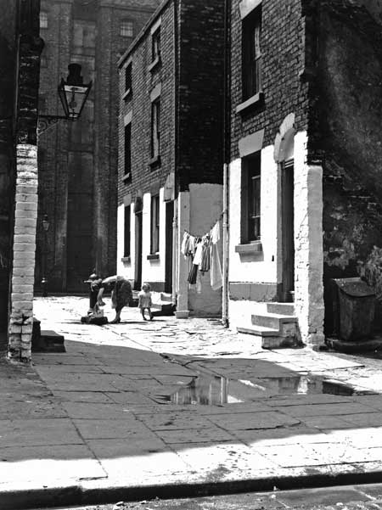

Slide 8
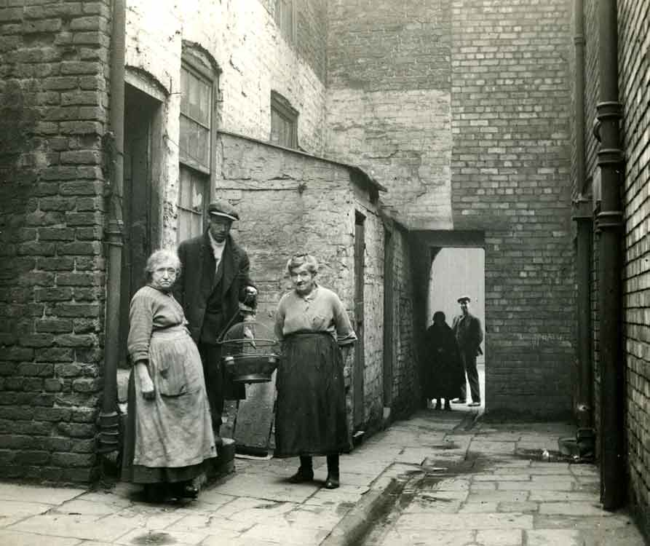

Slide 9
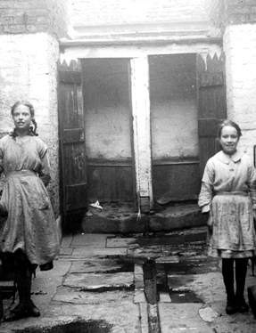

Slide 10
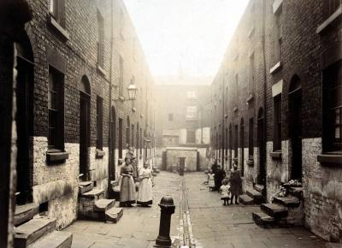

Slide 11
1866 Health Report
20,198 deaths
19,099 births
  “A town or country wherein there is a natural decrease of population may rightly be assumed to labour under the effects of some great moral or physical evil”

Slide 12
“In London it has been conclusively proved that the drinking water of some districts became, by contamination with the contents of sewers, the prolific source of the dissemination of the disease; but such was certainly not the case in Liverpool”

Slide 13
Death rates by ward
Death rates by age group
Pathological table
Meteorology Data by Quarter
Zymotic deaths by quarter
Typhus deaths by Week (1862 – 1866)
Typhus Deaths by age/Quarter
Typhus Deaths by Class/Ward
List of streets with 3 or more Typhus deaths and whether front or court
Cholera deaths by week
Cholera deaths by week/temperature
Daily diarrhoea and cholera deaths with pressure/temperature/rain/wind
Details of deaths in courts
Population and deaths in fever districts by street
Registry of streets with names of dead, occupation, age and sex with notes on the location of a privy. (80 pages)
Summary of daily deaths of cholera by age, sex and locality
Diarrhoea deaths by age, location and quarter
Lists of streets with 4 or more deaths
Measles, Whooping cough and scarlatina deaths by quarter, age, sex
Remaining deaths grouped by quarter, age and sex
Statistics on overcrowding
Deaths in lodging houses

Slide 14
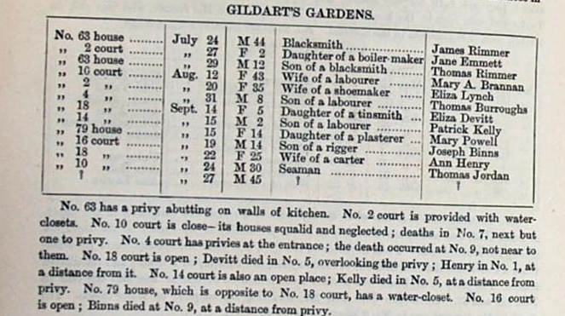

Slide 15
