Slide 1
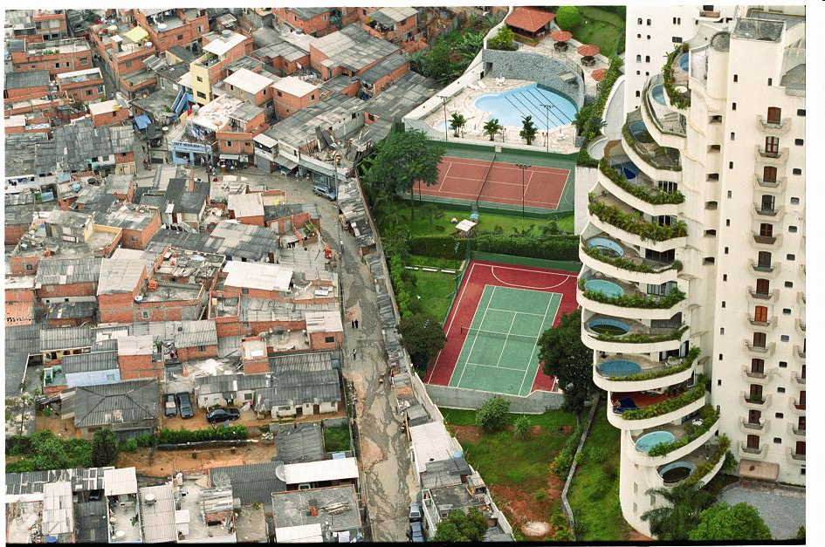

Spatial segregation and socioeconomic inequalities in health in Brazilian cities
http://www.ccsr.ac.uk/documents/spatial_segregation_of_poverty.pdf
An ESRC pathfinder project

Slide 2
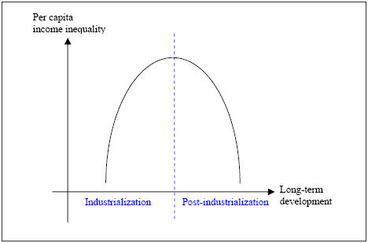
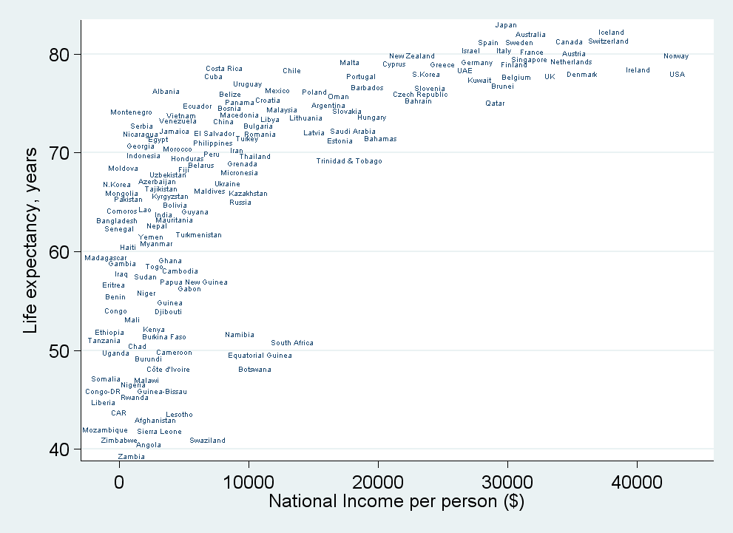
Preston Curve
Is the social gradient in health important for developing countries?
Two alternative hypotheses:
Income inequality accompanies economic development in industrialising countries
Income inequality results in poorer population health and lower life expectancy
Kuznetz Curve (1958)
Source: Wilkinson & Pickett, The Spirit Level (2009)

Slide 3
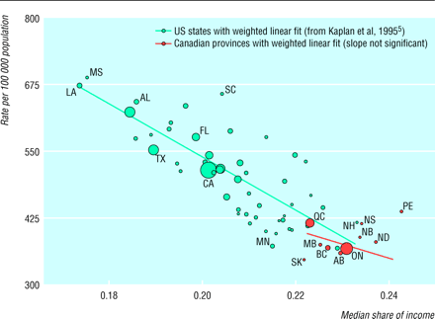
Male mortality (25-64 yrs) and income inequality in US states and Canadian provinces.
Source: Ross NA, Wolfson MC, Dunn JR, Berthelot JM, Kaplan GA, Lynch JW. British Medical Journal 2000;320:898-902

Slide 4
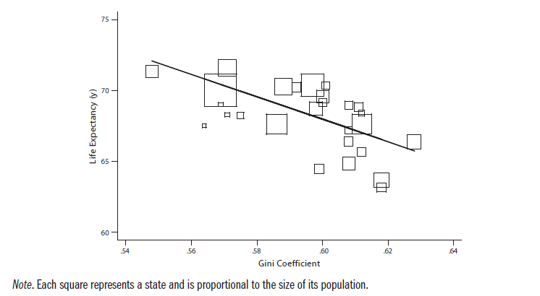
Life expectancy and income inequality: Brazil, 2000
Notes:
Plot showing the odds ratios (ORs) and 95% confidence interval (CI) for one-standard deviation change in Gini coefficient for the risk of being underweight, pre-overweight, overweight and obese.

Slide 5
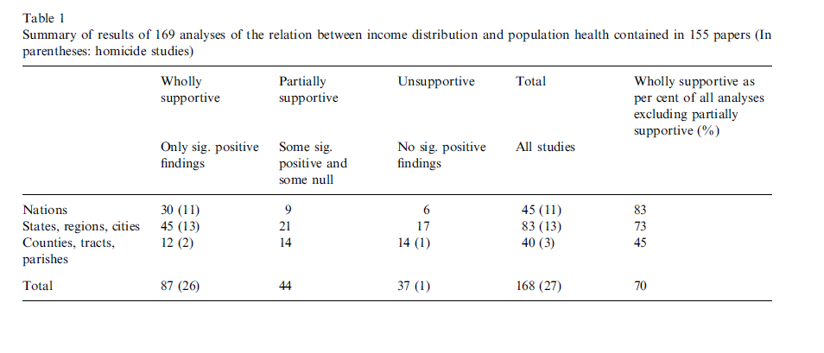
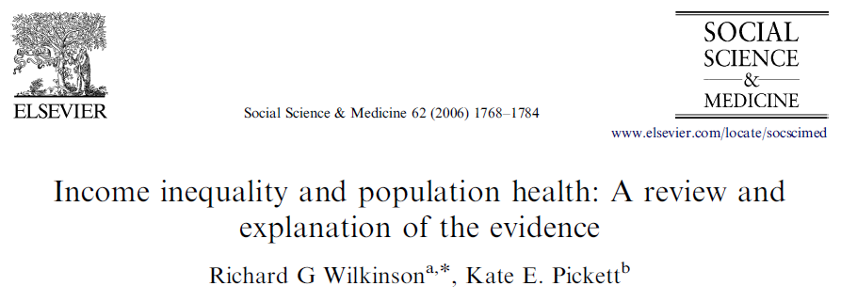
Size matters: for the association between income inequality and population health

Slide 6
non-poor
CBD: Central Business District
poor

Slide 7
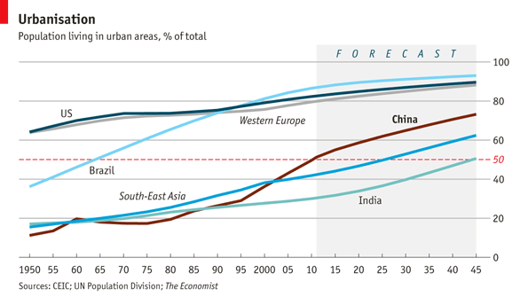
Increasing urbanisation in developing countries
http://filipspagnoli.wordpress.com/stats-on-human-rights/statistics-on-poverty/statistics-on-poverty-urbanization-and-slums/

Slide 8
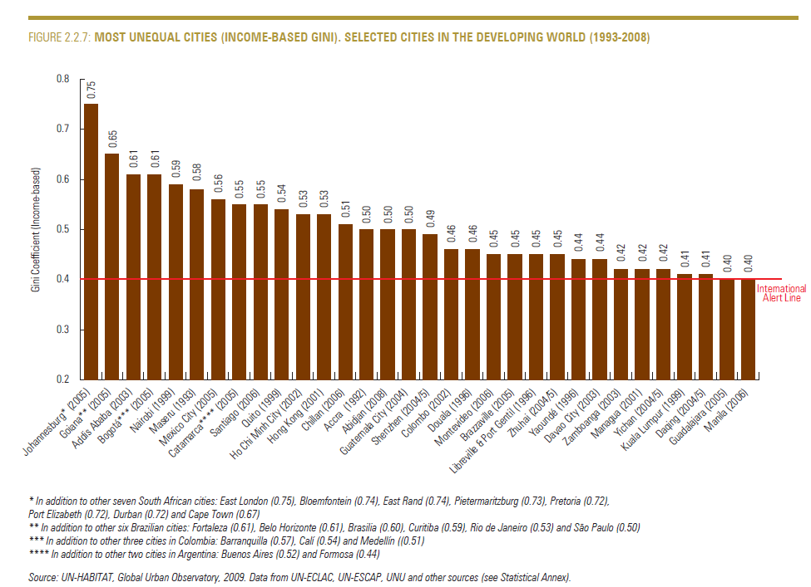

Slide 9
Spatial Inequalities and Development
Despite having a relatively high GDP per capita, Brazilian cities are highly unequal
urbanisation and concentration of economic activity
spatial concentration of affluence reproduces privileges of the rich
spatial concentration of poverty results in segregation, involuntary clustering in ghettos
Effects on population health and premature mortality/morbidity?
“Triple health jeopardy: being poor in a poor neighbourhood that is spatially isolated from life-enhancing opportunities…” Nancy A Ross

Slide 10
Socioeconomic segregation and the Spatial poverty trap
- Severe job restriction
Gender disparities
Worsening living conditions
Social exclusion and marginalisation
Lack of social interaction
High incidence of crime

Slide 11
Dimensions of segregation
Evenness: the unequal distribution of social groups across areal units of an urban area. Index of Dissimilarity
Exposure: the degree of potential contact between groups within neighborhoods of a city. Index of Isolation and Exposure
Clustering: extent to which areas inhabited by minority members adjoin one another in space. Index of clustering
Centralization: the degree to which a group is located near the centre of an urban area. Index of centralisation
Concentration: the relative amount of physical space occupied by a minority group in the urban environment. Index of concentration
However, these indices are aspatial measures.
This raises two issues relevant to the measurement of residential segregation:
The checkerboard problem
The comparability problem

Slide 12
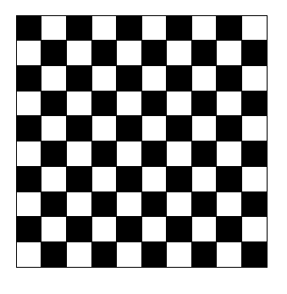
The checkerboard problem stems from considering each administrative unit in isolation from the others, thus neglecting the overall social composition of its surrounding space

Slide 13
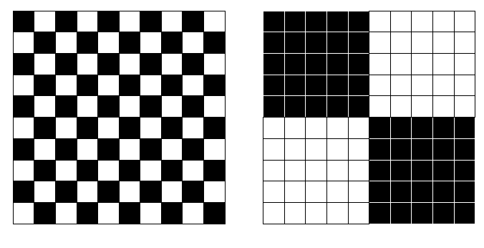
The checkerboard problem

Slide 14
The comparability problem
The comparability problem: different geographical areas are often divided into administrative units according to different criteria.
So when we equate neighbourhoods with administrative units, different areas will correspond to different definitions of neighbourhoods, thus making any comparison of segregation unreliable.
This is further compounded by changes in administrative area units over time.

Slide 15
The checkerboard and comparability problems
To tackle the checkerboard and comparability problems, new indices of residential segregation have been devised that take into account the spatial dimension of the phenomenon (e.g. Feitosa et al. 2004, O’Sullivan and Wong 2007).
These indices are based on definitions of neighbourhoods that are less sensitive to the nature of pre-existing administrative units.
STATA user command: spseg

Slide 16
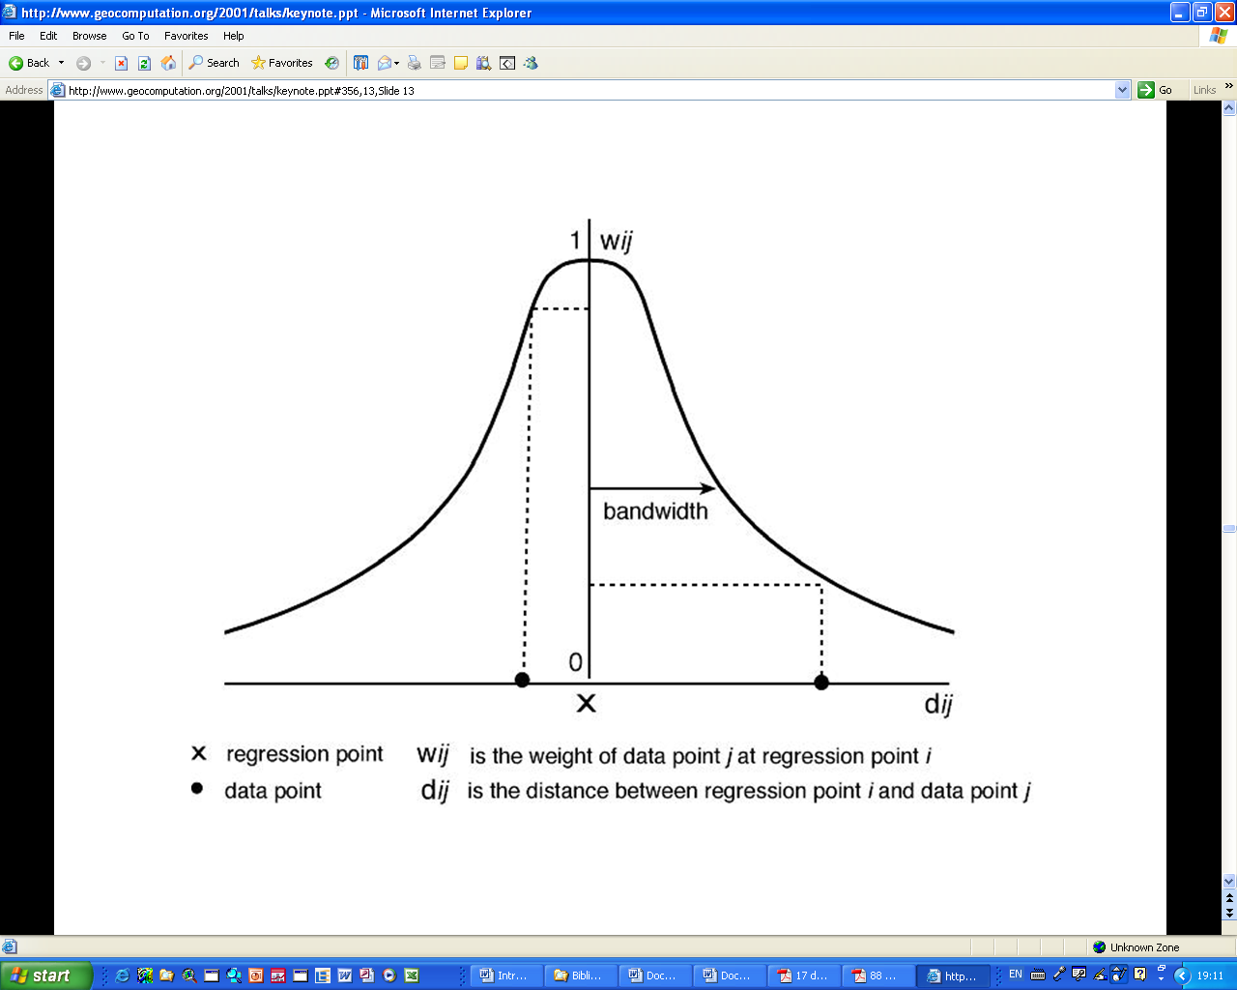
Neighbourhood definition, based on a Gaussian kernel decay function
i - centroid of a area i
j - centroid of area j
wij - the weight of data of area j at i
dij - the distance between centroid of
area i and centroid of area j
dij
dij
j
i
j
Adapted from Fotheringham et all, in http://www.geocomputation.org/2001/talks/keynote.ppt#356,13,Slide 13 Captured 17 December 2009.

Slide 17
Dimensions of spatial segregation

Slide 18
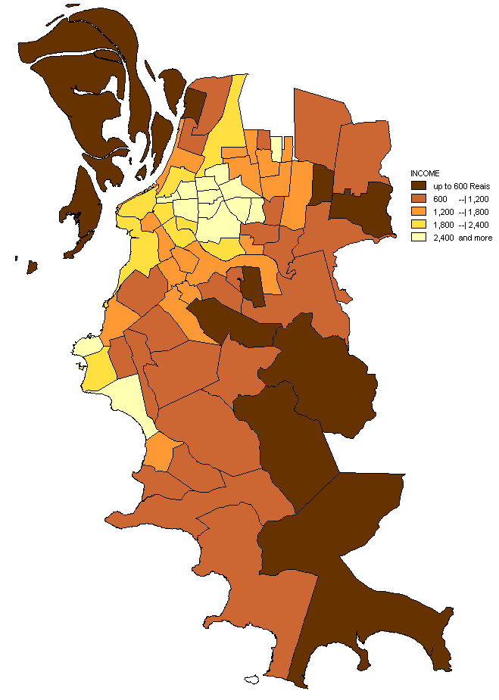
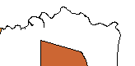
INCOME
Downtown
Guaiba River
and Bay
Moran I Index: 0.65 ( ρ< 0.0001)
Distribution of income of the head of the household by district, Porto Alegre, 2000.
Source: IBGE
Notes:
This is the distribution of the mean income of the head of the households, by districts.
Again we can observe that there is a spatial pattern. The rich people clustered around the central area of the city.
And what the map suggests, the Moran I Index confirms. There is a significant spatial autocorrelation.
This means that there is here a high degree of income inequality.
1 minimum salary 100 pounds per month
Em 2000, o salário mínimo era de R$151,00
O Dolar custava 1,8 reais
Logo o salario minimo era 84 dolares ou cerca de 50 libras
Mas o poder de compra (purchase power parity) → US$130,00 ou cerca de 80 Libras.
Mas considerando a inflacao da Libra, hoje essas 80 libras valeriam umas 100 Libras.

Slide 19
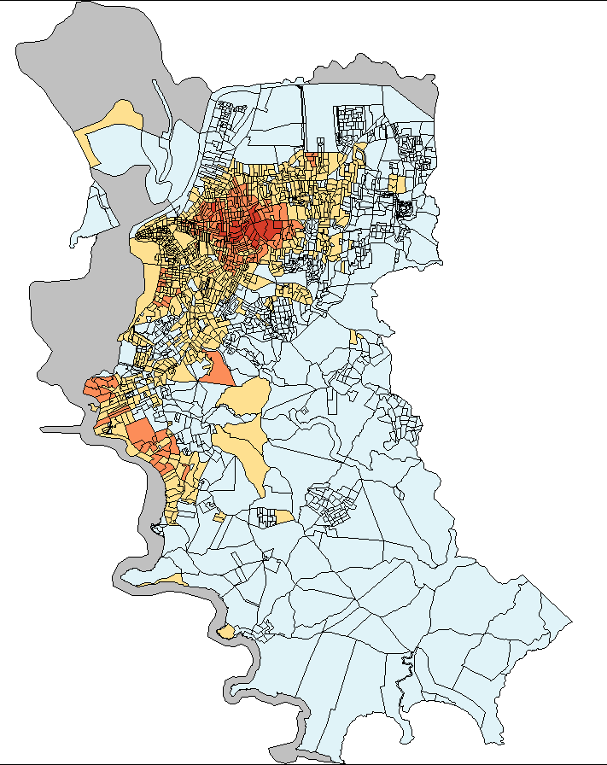
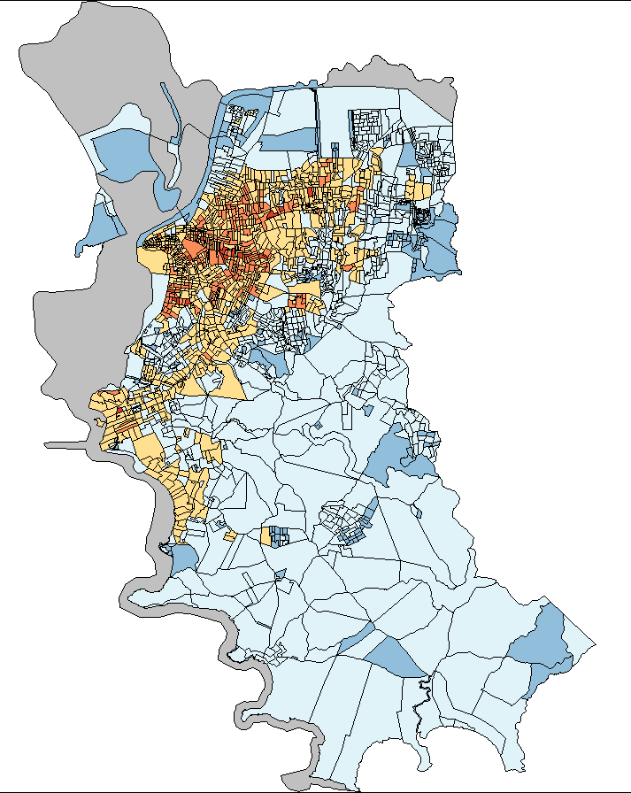
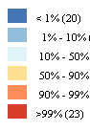
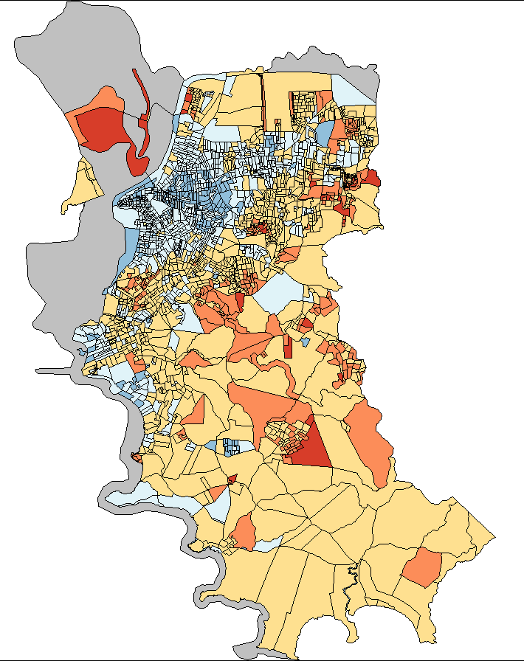
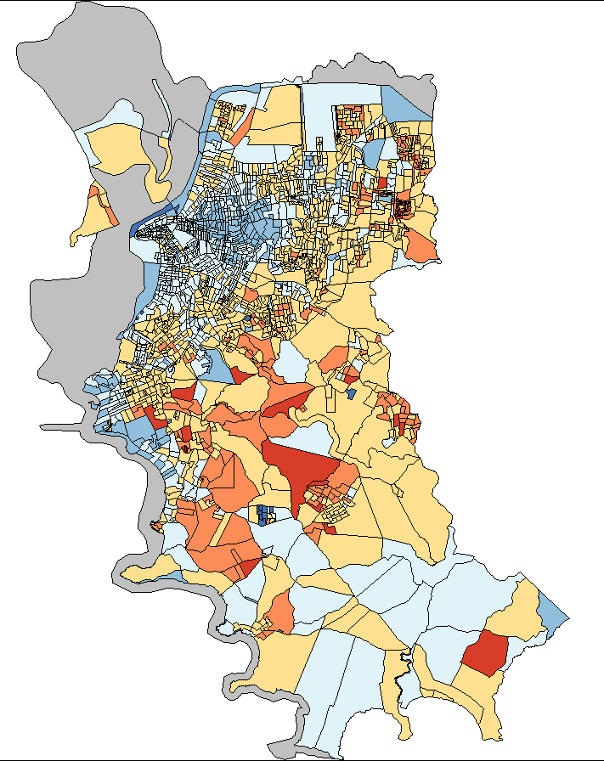
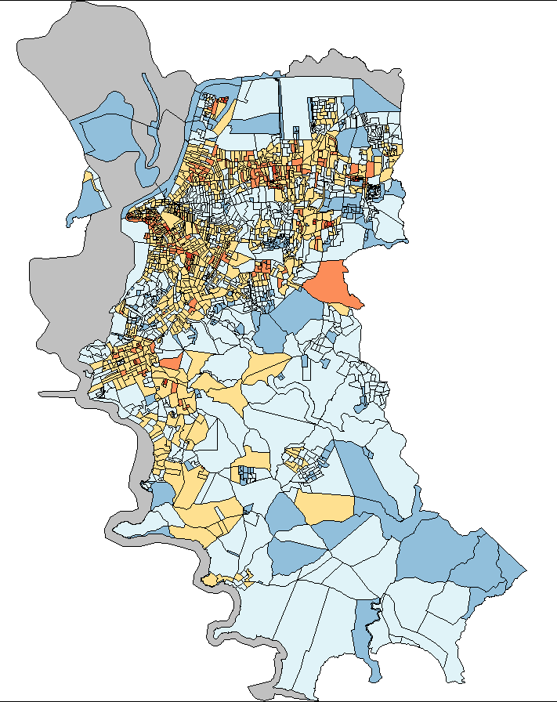
Local
Spatial Isolation Indexes
Income Groups
BW:400m
ms: minimum salaries
>20 ms
10-20 ms
<2ms
2-5 ms
5-10 ms
Notes:
And Here are the maps of local Spatial Isolation Index.
The richest people are isolated in the central area of the city.
It looks like an onion, several layers, each one representing the area where one income group lives, isolated from the others. The richest in the centre and the poorest in the distant suburbs.

Slide 20

Percentage of city population in Porto Alegre and global spatial isolation index by income group of head of household.
Income Group | Percentage of city population
20 or + ms | 6.0% | 0.23
10 to <20 ms | 24.1% | 0.20
5 to <10 ms | 29.1% | 0.24
2 to <5 ms | 24.4% | 0.29
>0 to <2 ms | 16.3% | 0.31

Slide 21
Scatterplot of Mortality by Mean Income, Income Inequality and Spatial segregation in 73 districts in Porto Alegre
Spatial isolation of the poorest
Income Inequality
Mean Income

Slide 22
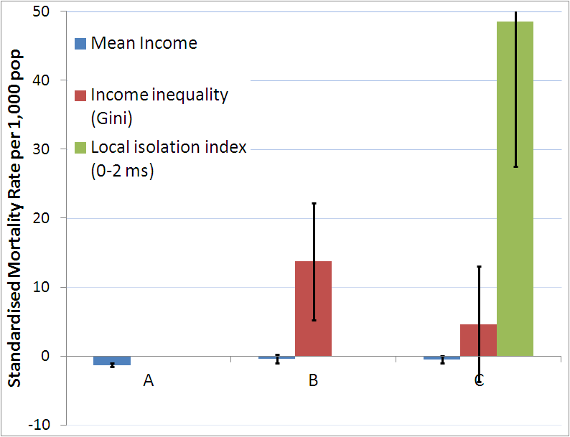
Association of income, income inequality and spatial segregation with total mortality rates in Porto Alegre districts.

Slide 23
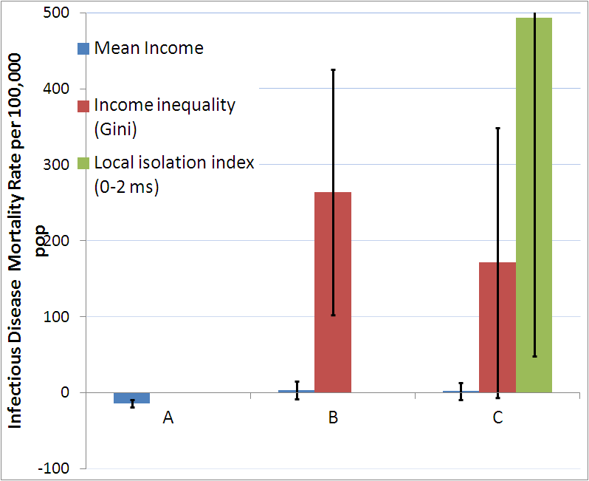
Association of income, income inequality and spatial segregation with infectious disease mortality rates in Porto Alegre districts.

Slide 24
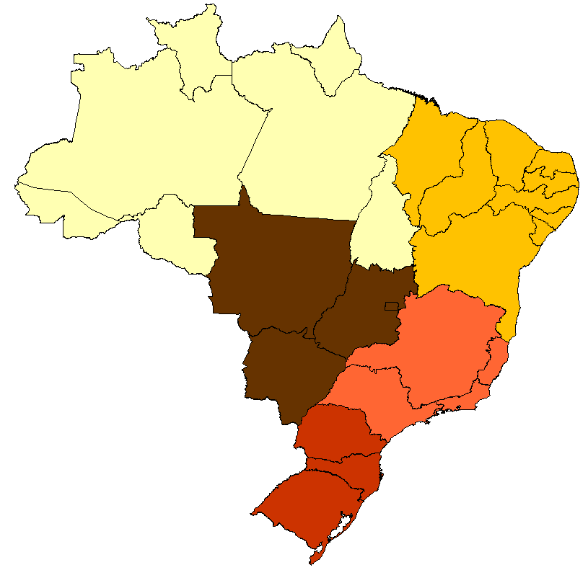
Brazilian regions, states and selected cities
North
Northeast
Teresina
Natal
João Pessoa
Recife
Aracaju
Brasília
Central-West
Campo Grande
Southeast
Rio de Janeiro
Curitiba
Porto Alegre
South

Slide 25
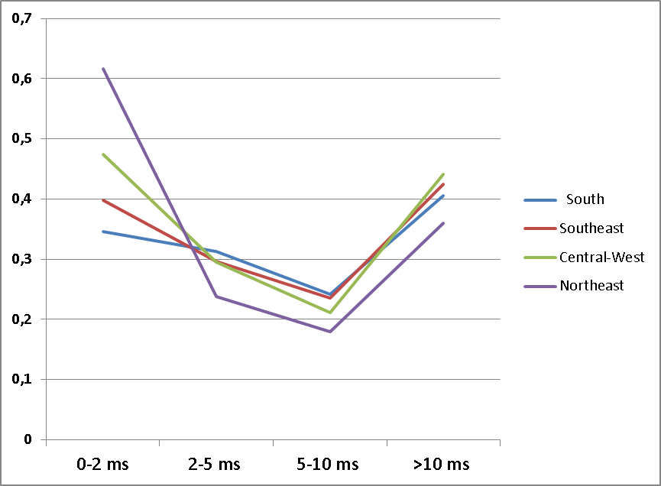
Spatial Isolation Index
Isolation Index
Income groups

Slide 26
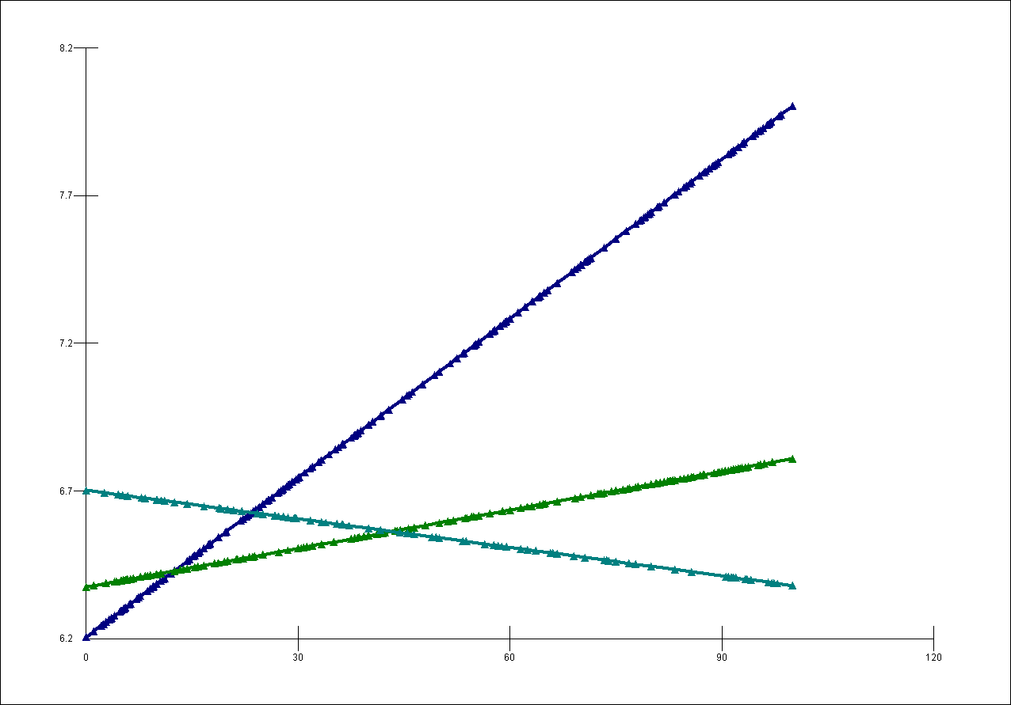
Predicted SMR by Spatial Isolation Index and Region
Restinga, Porto Alegre
South/South East and Central West Regions
SMR
North East Region
Ilha Joana Bezerra, Recife
Northern Region
Adjusted for Population Size and Poverty Rate in the District
Spatial Isolation Index of the poorest

Slide 27
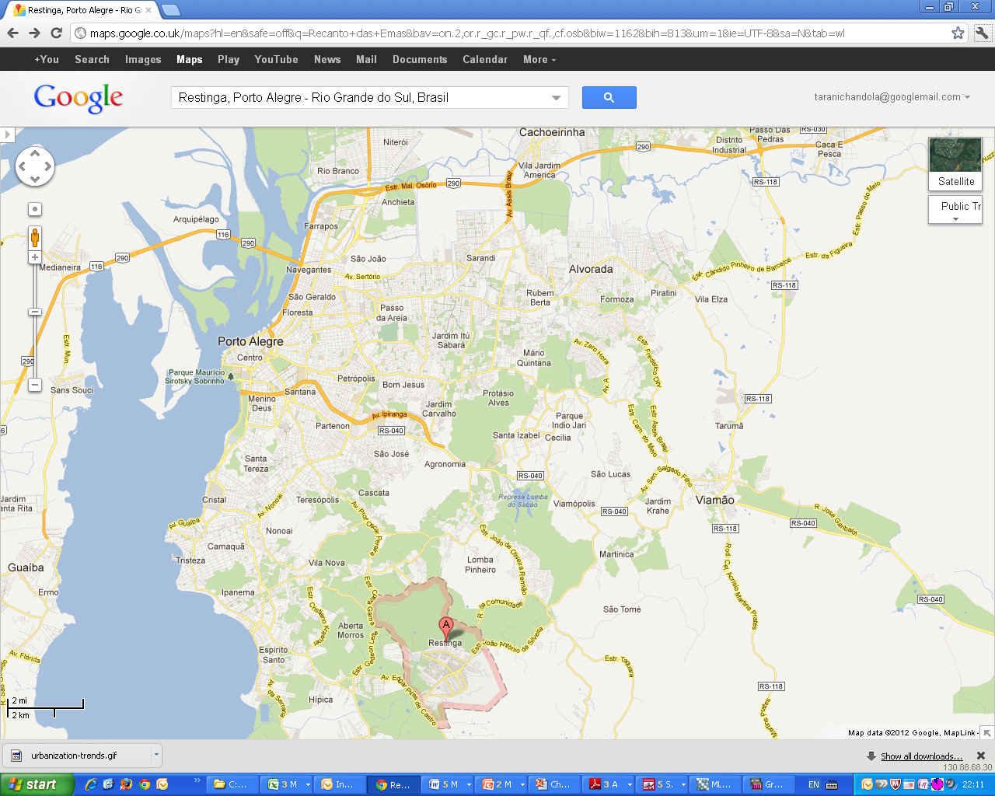

Slide 28
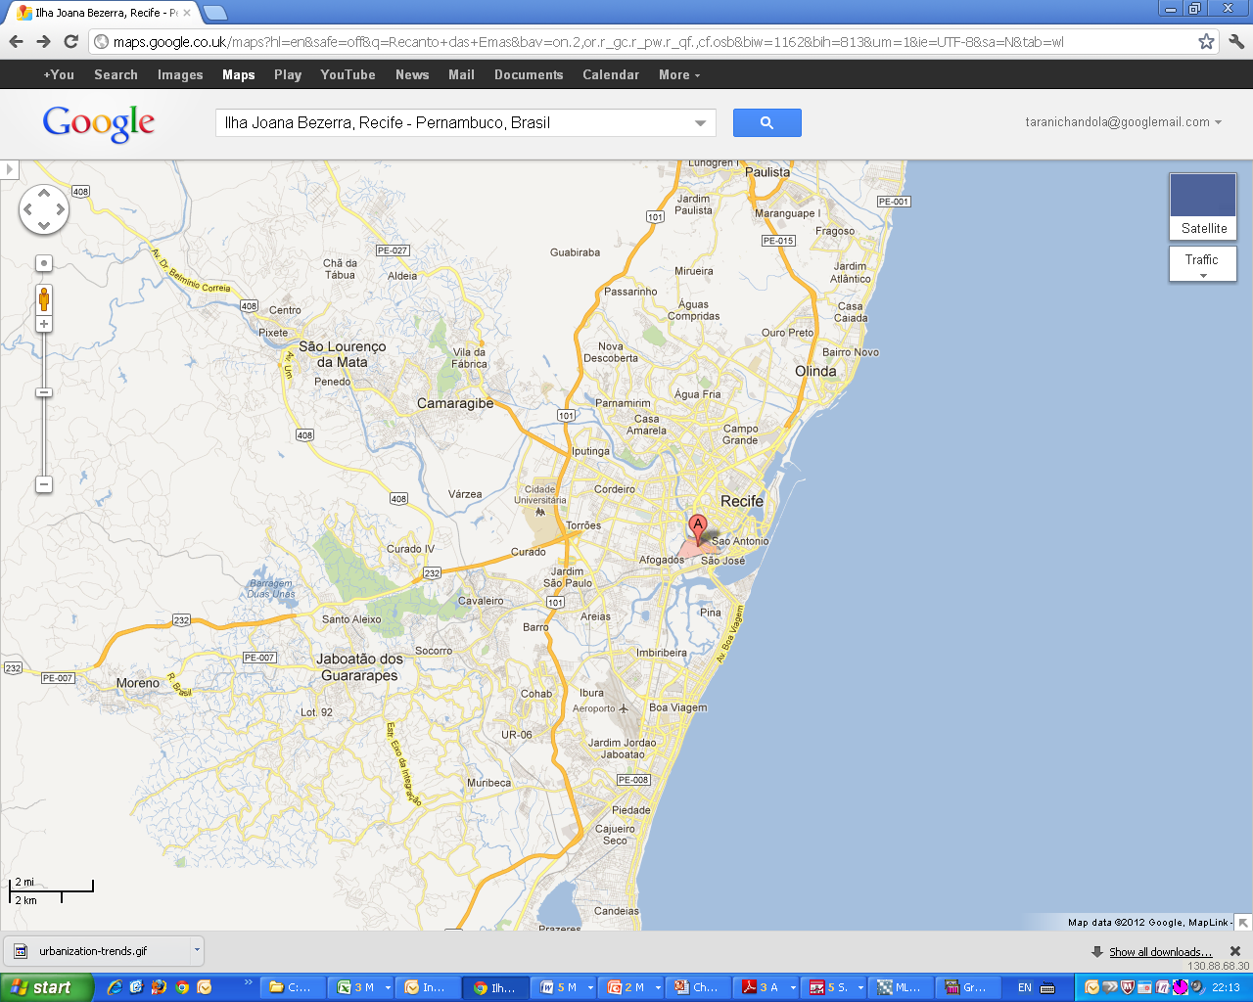

Slide 29
Discussion:
-“Triple health jeopardy”- revisited?
Living in a poor neighbourhood that is spatially segregated, in a developing city
- The spatial dimension of income inequality- residential segregation- is important for population health and mortality
- Living in a rich city is not protective (of mortality risk) if you live in a spatially segregated neighbourhood
- Implications for urban development and slum resettlement in other countries

Slide 30
Summary
Districts in Brazil with higher poverty rates have higher mortality rates
Districts where the poor are spatially isolated also have higher mortality rates
- Interaction between Region and Spatial Isolation of the poor: The association of spatial isolation with mortality is strongest in cities in the richest (Southern) regions
- Increasing the spatial isolation of the poor within rich cities could result in poorer health and lower life expectancy.

