Slide 1
Is a fair voting system really achievable?
Contributed Presentation at Radical Statistics 2013 conference, York.
Russell Ecob

Slide 2
What happened in New Zealand in 1994?

Slide 3
What happened in UK in 2010 (and didn’t in 2011!)
In 2010 - UK general election (FPTP)
Conservatives 36% of votes but 47% of seats
LibDem 23% of votes but 9% of seats
(but Labour benefited as much as the Tories!)
In 2011- Referendum allowed for an AV alternative, this option agreed (?) on by the major parties – rejected soundly by electorate

Slide 4
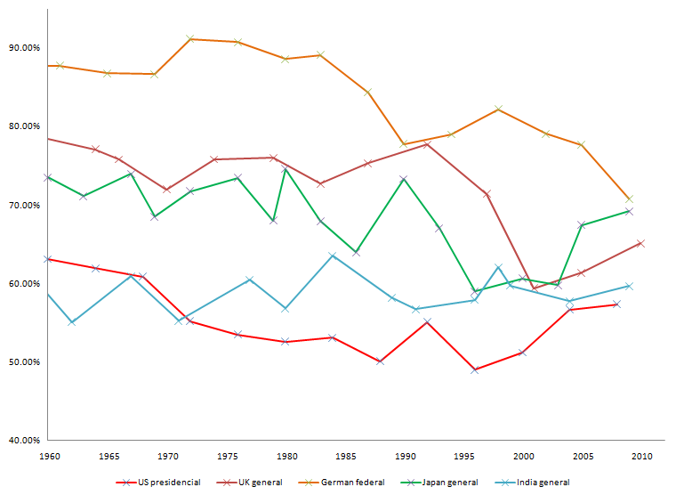
Voter turnout trends over time (1960-2010) in 5 selected countries

Slide 5
How proportional?
Deviation from proportionality over time in 6 selected countries (Gavin Thompson, Significance, Sept 2010)
FPTP (UK) 10-40 (%)` steady increase since 1951 (till 1987)
FPTP (US) 0-20 variable- no trend
AV (Aust) 20-30 increasing, jagged
STV (Irish H.O.Rep) 10-20 some recent increase
FPTP/AM (NZ) 0-50 (FPTP) steady increase to 1994
5 (AM) stable after 1994
Open List(Neth) 5 stable

Slide 6
Plan of talk
Required and desirable characteristics (my suggestions)
Where existing systems fall down
My proposal
Evaluation of this proposal
Possible agenda for breakout

Slide 7
4 Required characteristics
Proportional
Vote for a known (and canvassed) party representative
Use existing constituencies
One vote only

Slide 8
8 Desirable characteristics
No ‘wasted’ votes
Promotes high voter turnout
Elected representative should have most votes of all standing candidates
Robust to manipulation either due to party or to voter
All representatives have identical remits, priorities, and perceived statuses
Minority or single issue (local?) candidates should get fair representation
Easy and quick to tally
Easily understandable and transparent to the voter

Slide 9
Where existing systems fall down
FPTP- Not R1,not D1,4
AV⁺ - (e.g. Jenkins)……to come………
STV - (e.g. Farrell)……to come ………..
Additional List - Not R4, D5
FPTP can be VERY un-proportional!
Other systems (especially AV) are more proportional but still fall short

Slide 10
A proposal – Ranked Constituency Voting
This involves the production of a set of rankings of constituencies within each party together with the proportion of the electorate (or of voters?) who elect the party representative.
By selecting the representatives using this list information according to an optimal algorithm we will approximate proportionality.
Initial trials suggest that the precise algorithm may be relatively unimportant.

Slide 11
Breakout Agenda
Is proportionality (nationally) so important? At constituency level also? Are there other criteria to be considered? (voter turnout, manipulability, ‘strong’ government, lack of ‘churn’, lack of ‘wasted’ vote, etc etc) . How are these criteria empirically related ?
Discussion and critique of proposals (and of algorithm)
What happens when electoral systems change (New Zealand etc)?
Other proportional systems?
Implementation and feasibility/acceptability issues?

Slide 12
Running RCV algorithm on 10 selected constituencies’ results from 2010 UK election
  Cons Lab LD other
FPTP 8 1 1
RCV(1) 4 2 3 1
RCV(2) 5 2 3
Notes:
RCV1 – UKIP with others
RCv2-Ukip separate
Constituencies alphabetically from Newton Abbot (all England, south)

Slide 13
A few references
Stephen Johnson (2011) http://thoughtundermined.com/2011/04/20/direct-party-and-representative-voting/ (a weighted voting proposal which satisfies the 4 required characteristics_
Lundberg, TC (2006) Second Class Representatives? Mixed Member Proportional Representation in Britain. Parliamentary Affairs, Vol 59 no 1, 60-77.
Karp, JA and Banducci, SA (1999) The impact of Proportional Representation on Turnout: Evidence from New Zealand. Aust. J of Political Science, Vol 34, no 3. 363-377.
Gavin Thompson (2010) Keeping things in proportion: how can voting systems be fairer? Significance, Sept 2010, Vol 7 no 3.

