Slide 1
Population projections: planners and developers versus the people – the political economy of “evidence” in practice.
David Byrne for Radstats 2013
dave.byrne@durham.ac.uk

Slide 2
Outline
The example – The Newcastle / Gateshead One Core Strategy.
Population projections as “evidence” – the use of “science” in planning.
The technical issues:
Which population projection?
Which area? – the casing question.
What causes ‘population’? – the causal chain considered.
Components of population change.
Employment prospects.
Housing demand versus housing need.
The bizarre political economy of housing land development.
Planning for Cities4People?

Slide 3
The One Core Strategy
What’s wrong with it!

Slide 4
Key Features
Predicts considerable growth in population
From this infers considerable increase in the number of households
From this infers considerable increase in effective demand for housing
From this decides that most of this housing should be build on peripheral ‘green field’ sites.

Slide 5
What is misses
The recession becoming a depression
massive fall in real household incomes as inflation rises faster than earnings
Considerable rise in unemployment in consequence of:
Public sector service cuts
Impact on consumer services
THE FUNDAMENTAL STRUCTURAL PROBLEMS OF THE UK ECONOMY IN GENERAL AND THE NE ECONOMY IN PARTICULAR
Consequent rising net emigration both of EU accession state nationals returning home or going to Germany AND young UK adults with requisite skills emigrating particularly to Australia

Slide 6
Population Projections and they do change –Newcastle /Gateshead

Slide 7
ONS Estimates of Total Population by 2030 for Newcastle and Gateshead
Year | 2010 Projection | 2008 Projection | 2006 Projection | 2004 Projection
2010 | 475.0 | 473.9 | 465.8 | 452.1
2030 | 507.0 | 512.2 | 492.4 | 442.1

Slide 8
Which area to plan for? Or What is the Case?
Newcastle and Gateshead?
Tyne and Wear County which has the best urban rapid transit system in the UK?
The Tyne Wear City Region?

Slide 9
How planning was done and how it is done.
It was done by:
1970s: Regional bodies and regional strategies – object: employment.
1970s: Tyne and Wear Council – object: the whole shebang i.e. employment, environment, transport etc.
1980s until 2010: bun fight among LAs but very well refereed by Government Office NE – object housing start numbers.
Since 2010: Individual LAs like rats fighting in a barrel – object apparently housing start numbers.

Slide 10
What causes what?
Does population cause jobs?
Do jobs cause population?
Does the interaction of the global, national, regional and local economies cause jobs?
Does population cause households?
Do households cause housing demand?
Does housing stock cause housing demand?

Slide 11
Components of Population Change
According to ONS
Births
Deaths
Internal Migration in.
Internal Migration out.
International Migration in.
International Migration out.
Cross border Migration in.
Cross border Migration out.

Slide 12
Components of Population Change – Tyneside City Region
Natural Change (births and deaths and life expectancy).
UK in migration not students – not much.
UK out migration not students – lots.
International in migration workers ??
International out migration workers??
Student in migration – lots for now but??
Student out migration – more than in migration.
Refugees in ??

Slide 13
Adjusted Employment Projections by Broad Sector Group (values in thousands)
Sector Group | Newcastle |  | Gateshead |  | Both Authorities
 | 2010 | 2030 | 2010 | 2030 | 2010 | 2030
Primary and Secondary | 1.2 | 0.8 | 0.0 | 0.0 | 1.2 | 0.8
Manufacturing | 10.3 | 9.5 | 14.8 | 13.9 | 25.1 | 23.4
Utilities | 0.7 | 0.4 | 0.6 | 0.4 | 1.3 | 0.8
Construction | 8.6 | 9.1 | 10.1 | 11.7 | 18.7 | 20.8
Retail, Distribution and Transport | 48.6 | 54.8 | 33.8 | 35.8 | 82.4 | 90.6
Business and financial services | 47.3 | 56.4 | 17.5 | 21.3 | 64.8 | 77.7
Public Services | 75.8 | 75.5 | 29.7 | 31.1 | 105.5 | 106.6
Total | 192.4 | 206.3 | 106.6 | 114.4 | 299.0 | 320.7

Slide 14
Employment Changes 1995 to 2008
Total employment increased by 37,000 – 16%
Manufacturing employment decreased by 10,000 – 30%
Construction employment increased by 1,200 – 13%
All services employment increased by 45,000 – 24%
Public services employment increased by 20,000 – 29%
Other services employment increased by 27,000 – 23%

Slide 15
The figures above show that more than half of the growth in that employment has been in the public sector. The two authorities preparing this plan have already in the first year of deficit driven budgets cut more than 1,600 jobs between them. Gateshead Health is scheduled to lose more than 330 jobs. Newcastle College is cutting 170 jobs. The trend in public sector employment is absolutely downwards. There is no prospect in a recession of private services employment increasing. Given that the boom years were dependent on consumption financed by debt and borrowing against increases in house values, private consumption across retail and related service sectors is already in free fall.
In the North East manufacturing employment has dropped from 212,000 jobs (20% of all employment) in 1996 to 107,000 jobs (9% of all employment) by June 2011 with 30,000 jobs being lost since 2008, the date of the figures above. Since 2008 the retail sector has lost 15,000 jobs in the North East Region. Construction employment remained steady across the period until 2008 but this peaked regionally at 104,000 jobs in 2009 and has already lost 20,000 jobs since that date. The impact of the recession / depression is already with us but the one racing certainty for the future is that it is going to get worse across these sectors.

Slide 16
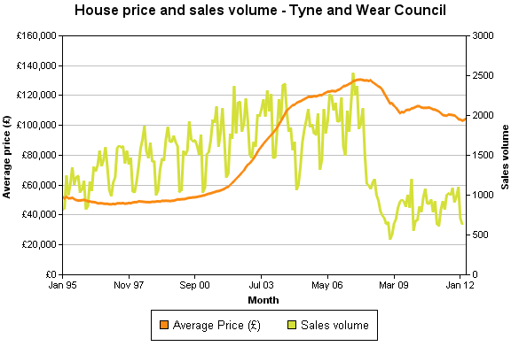
The local housing market.

Slide 17
Housing Waiting Lists

Slide 18
The bizarre political economy of housing land development.
Housing sales are collapsing.
Developers have completed houses they can’t sell.
Developers have semi-completed houses they have plasticated up.
Developers own sites with planning permission on which no development is planned.

Slide 19
So why do they want redesignation for green belt sites?
They might build some high value houses where there is some demand.
Redesignating these sites will increase their asset value.
But will this increase their share price if their profits are rubbish? Probably not.
BUT it will justify banks continuing to lend to them against assets.

Slide 20
Possible Result
More Bank bad debts.
God forbid they use this to create new derivatives.
YOU COULD NOT BELIEVE IT!

