Slide 1




Inequalities in well-being in later life
James Nazroo
Sociology and Cathie Marsh Centre
james.nazroo@manchester.ac.uk

Slide 2
An ageing world
[Nothing] is more likely to shape economic, social, and political developments in the early twenty-first century than the simultaneous aging of Japan, Europe, and the United States … The human life cycle is undergoing unprecedented change. To preserve economic security, we must adapt the social institutions built around it to these new realities.
Demographic aging brings with it a systematic transformation of all spheres of social life … beneath even the daunting fiscal projections, lies a longer-term economic, social and cultural dynamic … What will it be like to live in societies that are much older than any we have ever known or imagined?
The Commission on Global Aging (1999)

Slide 3
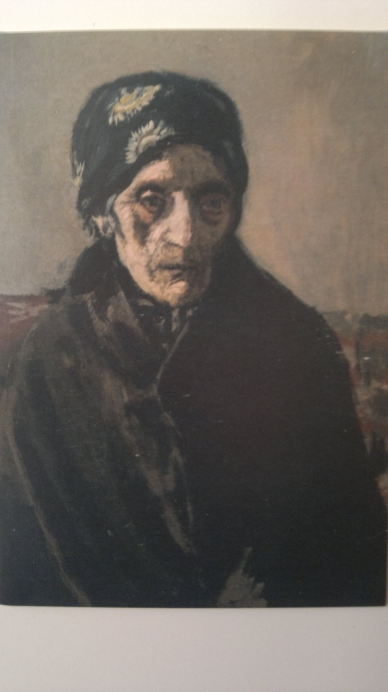
Changing images of ageing
The title means ‘my mother, poor thing’
Contemporary critics found this image shocking at a time when it was thought that the elderly should be represented with respect or with sentiment.
Sickert instead treads a fine line between complete honesty and brutality applying the paint in small dabs and touches so that the face has the crumbling texture of great age.
Mamma Mia Poveretta (1901-04)
Walter Richard Sickert

Slide 4
A Third Age?
Healthy, wealthy and engaged in society
Post-retirement, post-parenting, but pre-dependency.
Contributing to society:
  Voluntary/community activities;
  Political/civic engagement.
Consuming and enjoying life, leisure and pleasure – cultural mainstream.
Self-fulfilment:
  Having a role;
  Having status;
  Having fun.
Greedy, self-interested baby-boomers?
But the resources to enjoy a ‘third’ age, are strongly related to socio-economic position – class inequalities are likely to persist post-retirement.

Slide 5
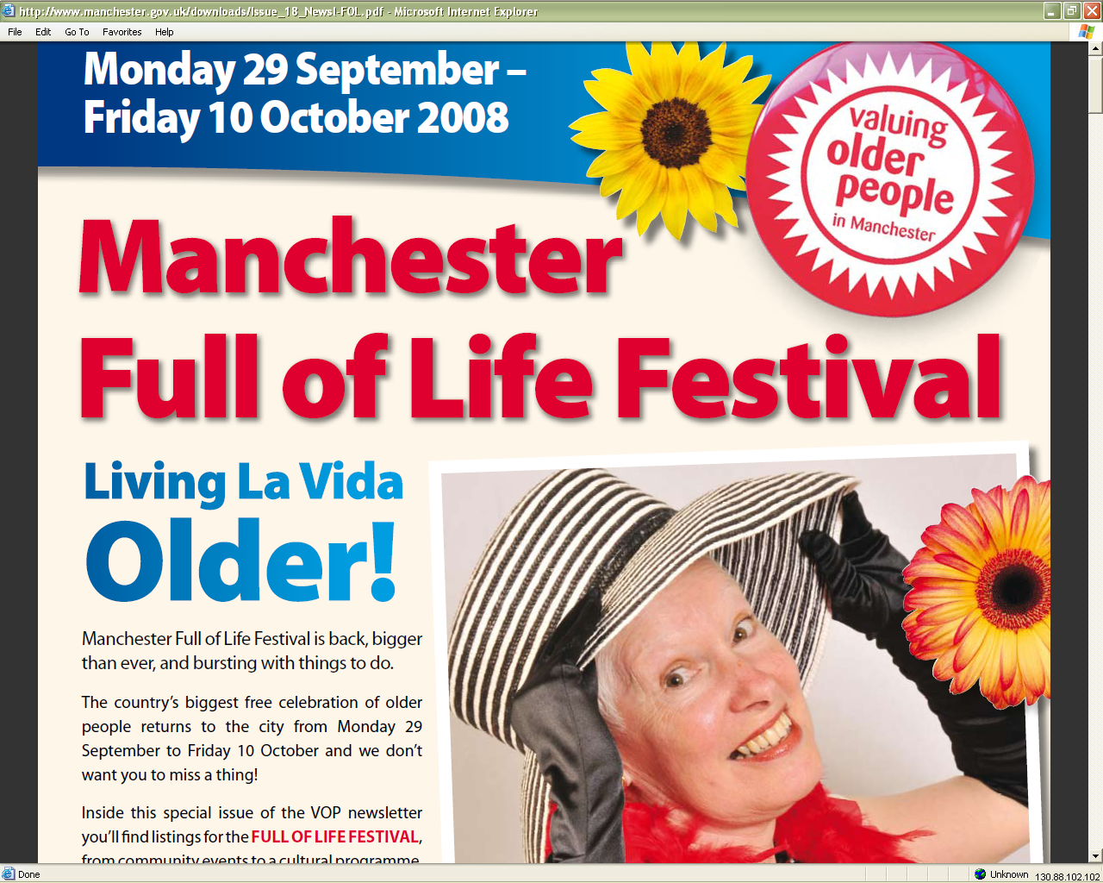
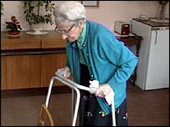
Contrasting images of ageing: Reflections of class?
A political storm is brewing over proposals to raise the state pension age to 67
(BBC News 2005)

Slide 6
Research questions
How does wellbeing evolve in later life (a U-shaped effect (Blanchflower and Oswald 2008))?
What are the effects of age cohort and ageing (cross-sectional and longitudinal) on wellbeing?
Is there evidence for a third age (Laslett 1989) and what role does retirement have in this?
Do different measures show similar effects?
What does ageing substantively mean?
  Only a change in conditions and circumstances (health, social support, partnership, economic status, …), or something more?
  Does controlling for circumstances explain age and ageing effects?
What evidence is there for class inequalities and inequalities that persist across age cohorts?

Slide 7
The English Longitudinal Study of Ageing
(www.ifs.org.uk/elsa)
A panel study of people aged 50 and older, sixth wave of data collection available very soon, with additional wave 0 data available
Sample at wave 1 (2002) was approximately 11,400 people born before 1st March 1952 who were in the private household sector. Drawn from Health Survey for England (wave 0).
Face to face interview every two years since 2002, with a biomedical assessment carried out by a nurse every four years.
Those incapable of doing the interview have a proxy interview.
End of life interviews are carried out with the partners or carers of people who died after wave 1.
Detailed content on: demographics, health, performance, biomarkers, wellbeing, economics, housing, employment, social relationships, social civic and cultural participation, life history.
Sister study to HRS, SHARE, KLOSA, CHARLS, etc.
Notes:
7
7

Slide 8

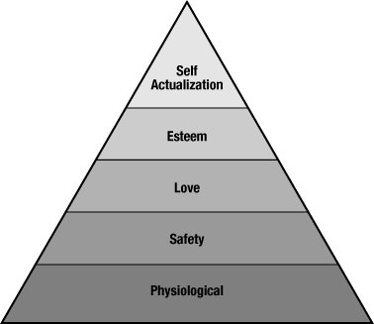

Approaches to measuring wellbeing
How do we adequately capture different dimensions of wellbeing?
Hedonic wellbeing:
  Maximisation of pleasure, minimisation of suffering (Aristippus of Cyrene, Epicurus, Bentham, Mill);
  Affective and cognitive dimensions;
    Both positive and negative affect – CES-D depression symptoms in ELSA;
    And evaluation of life – Diener satisfaction with life in ELSA.
Eudaimonic wellbeing:
  Personal development and realising one’s
  potential (Aristotle, Erikson 1959, Maslow 1968);
  Many operationalisations – CASP in ELSA.

Slide 9
Analytical methods
Longitudinal multilevel growth models, observations (level 1) nested within individuals (level 2), to give overlapping cohorts.
Model the association between wellbeing and age cohort and ageing, with adjustment for a range of (time-varying) covariates:
  Demographic factors (gender and ethnicity);
  Marital status;
  Socioeconomic factors (wealth, occupational class, economic activity and education);
  Health (limiting longterm illness, ADLs, IADLs, chronic conditions);
  Social support (close contacts, support from contacts, caring and volunteering activities) .
Observed over eight years (six years for some of the analyses), using an unbalanced sample, average of 3.1 years follow up.
Some analyses stratified by population group (wealth quintiles).

Slide 10
Age and negative affect
(CES-D score adjusted for gender and ethnicity)

Slide 11
Age and cognitive wellbeing
(Diener satisfaction with life score adjusted for gender and ethnicity)

Slide 12
Age and eudaimonic wellbeing
(CASP quality of life score adjusted for gender and ethnicity)

Slide 13
Age and negative affect: explaining the relationship
(CES-D score adjusted for gender and ethnicity)

Slide 14
The impact of retirement on wellbeing
Model transitions into retirement compared with those still working, for those aged 70 or younger and who are economically active.
Examine effects of wealth on retirement and route into retirement (routine, voluntary, involuntary):
  Routine retirement, because ‘reached retirement age’
  Voluntary:
    To enjoy life;
    To spend time with partner or family;
    Fed up with job and wanted a change;
    To give the younger generation a chance;
    Offered reasonable financial terms to retire early.
  Involuntary:
    Ill health (own, or of a relative/friend);
    Made redundant;
    Could not find another job.

Slide 15
Depression and type of retirement transition

Slide 16
Age and negative affect: explaining the relationship
(CES-D score adjusted for gender and ethnicity)

Slide 17
Age and negative affect: explaining the relationship
(CES-D score adjusted for gender and ethnicity)

Slide 18
Age and negative affect: explaining the relationship
(CES-D score adjusted for gender and ethnicity)

Slide 19
Age and negative affect: explaining the relationship
(CES-D score adjusted for gender and ethnicity)

Slide 20
Age and negative affect: explaining the relationship
(CES-D score adjusted for gender and ethnicity)

Slide 21
Age and cognitive wellbeing, full model
(Diener satisfaction with life score adjusted for gender and ethnicity)

Slide 22
Age and eudaimonic wellbeing, full model
(CASP quality of life score adjusted for gender and ethnicity)

Slide 23
Age cohort, ageing and cognitive wellbeing:
Partial model
Notes:
And finally this plots shows a faster decline in life satisfaction at older ages with an increase over time for those aged 60 at baseline
Change in age specific slope remains after controls
> We are mainly explaining age instead of ageing
Possible Causes:
Measurement issues
Missingness
Period effects?
Aspects of ageing we are not measuring?

Slide 24
Age cohort, ageing and cognitive wellbeing:
Partial and full model
Notes:
And finally this plots shows a faster decline in life satisfaction at older ages with an increase over time for those aged 60 at baseline
Change in age specific slope remains after controls
> We are mainly explaining age instead of ageing
Possible Causes:
Measurement issues
Missingness
Period effects?
Aspects of ageing we are not measuring?

Slide 25
Age, negative affect and wealth
(CES-D score adjusted for gender and ethnicity)

Slide 26
Fair/poor self reported health and wealth
Men
Women
Notes:
26

Slide 27
Fair/poor self reported health and wealth
Men
Women
Notes:
27

Slide 28
Survival rates by wealth, age 50+
Women
Men

Slide 29
The distribution of financial wealth, age 60-74

Slide 30
Social mobility: odds to be in a professional or managerial class for four age cohorts
 | Year of birth
 | < 1920 | 1920-29 | 1930-39 | 1940-45 | 1946-52
Class of origin
Semi/un-skilled manual | 1 | 1 | 1 | 1 | 1
Skilled manual | 1.46 | 1.39* | 1.35 | 1.51 | 1.26
Administrative/Skilled non-manual | 1.86* | 3.30 | 2.76 | 2.31 | 2.06
Manager/professional | 2.76 | 4.94 | 4.02 | 3.40 | 3.32
Female | 0.37 | 0.29 | 0.53 | 0.61 | 0.65
Bold figures p < 0.05, *p < 0.1

Slide 31
Concluding comments: well-being in later life
Different measures different stories:
  Negative affect: higher levels of depressive symptoms in older cohorts can almost entirely be explained by conditions;
  Cognitive wellbeing: controlling for conditions, people evaluate their life (satisfaction with life) more positively in older cohorts;
  Eudaimonic wellbeing: quality of life declines with older cohorts, although this effect is diminished in fully adjusted models.
Ageing effects vary by cohort.
And we are explaining age cohort more than ageing:
  Measurement issues;
  Period effects;
  Aspects of ageing we are not measuring?
And the conditions we adjust for are not randomly distributed across the population.

Slide 32
Concluding comments: well-being in later life
Age and transitions:
  Marital status (divorce and widowhood);
  Health/disability;
  Wealth;
  Retirement status/route (voluntary).
Social class
Cohort and generation:
  Occupational structures;
  Pension arrangements;
  Retirement choices/opportunities;
  Marriage choices;
  But persisting inequalities.

Slide 33
Acknowledgements
Funders
A range of colleagues
  Stephen Jivraj
  Bram Vanhoutte
  Alan Marshall
  Simone Scherger
  Amanda Connolly
  Nitin Purandare
  Tarani Chandola
  Neil Pendleton

