Slide 1
Is the relative measure of child poverty a help or a hindrance?
Graham Whitham
Graham_whitham@hotmail.co.uk
@GrahamWhitham
For Radical Statistics Conference, 8th March 2014, Manchester.

Slide 2
Overview
Relative poverty as a concept
Child poverty targets
Child poverty today
Changes in rates of child poverty between 1999 and 2020
The policy debate about child poverty measurement
Are there alternative approaches?
Concluding thoughts.

Slide 3
Background to poverty measurement in the UK
Poverty as a relative concept is nothing new:
“By necessities I understand not only the commodities which are indispensably necessary for the support of life but whatever the custom of the country renders it indecent for creditable people, even of the lowest order, to be without.”
Smith, Adams, first published in 1776, Wealth of Nations
But it developed as a concept in the UK from through the 20th Century as we have moved away from the worst aspects of hardship and want.

Slide 4
Background to poverty measurement in the UK
“Individuals, families and groups in the population can be said to be in poverty when they lack the resources to obtain the types of diet, participate in the activities, and have the living conditions and amenities which are customary, or at least widely encouraged and approved, in the societies in which they belong”.
Townsend, P. (1979) Poverty in the United Kingdom: a survey of household resources and standards of living. p.31. Penguin

Slide 5
Labour’s initial targets
Commitment:
“Our historic aim will be for ours to be the first generation to end child poverty, and it will take a generation. It is a 20 year mission but I believe it can be done.”
Tony Blair, Beveridge Lecture, Toynbee Hall London, 18/03/99
Initial targets:
To reduce child poverty by one quarter of its 1998/99 level by 2004/05
To reduce child poverty by half of the 1998/99 level by 2010/11

Slide 6
Labour introduced, and the coalition is formally signed up to, four child poverty targets for 2020
Less than 10% of children living in relative low-income, that is household income below 60% of the contemporary median
Less than 5% of children living in absolute low-income, that is household income below 60% of the 2010– 11 median in real terms
Less than 5% of children living in relative low-income plus material deprivation, that is below 70% of contemporary median income plus material deprivation
A persistent poverty measure, that is below 60% of contemporary median income for three out of the past four years

Slide 7
Child poverty today
In 2011/12:
3.5 million children (27%) living in relative poverty (below 60% contemporary median incomes) after housing costs, 2.3 million (17%) before housing costs.
3.8 million children (29%) living in absolute poverty (below 60% 2010/11 median incomes held constant), 2.5 million (20%) before housing costs.
Whilst the risk of poverty remains higher for certain groups (disability, single parent households, workless households etc…), of those living in poverty (figures are for relative poverty after housing costs):
66% are in working households.
64% are in couple families (married or cohabiting).
76% are white.
27% are only children and 40% are one of two children.
70% live in ‘non-disabled’ households.
So child poverty doesn’t just affect those in ‘at risk’ groups.

Slide 8
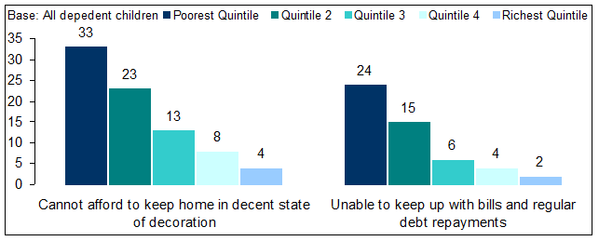
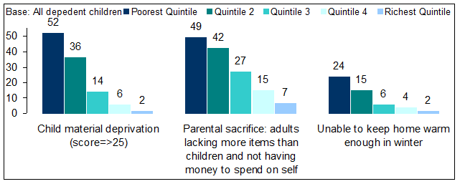
Huge inequality in outcomes and experiences for children
Housing conditions and debt by equivalised household income quintile (AHC)
Material deprivation by equivalised household income quintile (AHC)
Analysis by NatCen on behalf of Save the Children. Data is from the Family Resources Survey 2010/11. Incomes are measured after housing costs.

Slide 9
Progress made - % children in poverty
Period of real progress
Median incomes falling
Data from DWP Household Below Average Income data series. Absolute poverty figures shown based on holding 1998/99 incomes constant.
NB: BHC = before housing costs. Child poverty rates are considerably higher when measured after housing costs.

Slide 10
Progress in reverse – projected % children in poverty to 2020/21
By 2020 we will be back to where we were 20 years previously.
As median incomes recover, relative poverty is set to rise.
Source: HBAI 2011/12 and IFS projections (IFS Report R78). Absolute poverty figures relate to 2010/11 median incomes not 1998/99 as is the case with the previous chart. NB IFS projections are for each year to 2016/17 then in 2020/21. Author has imagined ‘steady’ change in the years between 2016/17 and 2020/21.

Slide 11
Why did child poverty fall and why is it about to go up?
The fall:
Benefits and tax credits for low-income families with children rose faster than inflation and more quickly than median incomes.
Had financial support merely risen with inflation, child poverty would have increased to around 4.3 million by 2010.
The ‘performance’ of parents in the labour market improved too. About a quarter of the fall in child poverty since 1998/99 can be linked to higher rates of employment among lone parents.
Regional variations in child poverty trends reinforce the importance of the labour market: Between 1998 and 2004, parental employment rose in the North of England and Scotland and these areas saw large falls in levels of child poverty.
The rise:
Driven by social security reforms and cuts
Universal Credit is ‘child poverty reducing’
But positive impact is minimal in the context of wider social security reforms
E.g. the decision to uprate benefits and tax credits by less than inflation (1%) between 2013 and 2016 increases child poverty
And what about:
Weakened position of parents in the labour market following recession? But long-term labour market trends mean employment likely to overcome the damage done by social security policy.
Mums being pushed out of the labour market?
Above is largely based on work by the Institute for Fiscal Studies and Mike Brewer of the University of Essex.

Slide 12
Making a mockery of the targets?
“It seems impossible that the targets set out in the Child Poverty Act could be met even if there were unprecedented changes in the labour market, welfare policy, and the amount of redistribution attempted by the state.”
IFS Report R78, Browne, Hood & Joyce 2013
Government is ‘committed to the Child Poverty Act and targets’ but where is the will and resources to ensure they’ll be met (see latest draft CP Strategy).
Consultation on child poverty measurement presented criticisms of the relative measure and a focus on household incomes generally.

Slide 13
What exactly is the criticism?
Is it about the concept of relative poverty?
Is it about the use of the 60% median poverty line in particular?
Is it about the use of income transfers in addressing child poverty?
Is it about the previous government’s record?
Is it about a focus on incomes generally?
Is it about the use of targets and legislation as a means of tackling poverty?
Is it about individual behaviours versus structural causes of poverty?
Is it about life chances and long-term outcomes for children versus everyday well-being and happiness?
Is it because a focus on income excludes other policy areas?

Slide 14
The relative measure in particular creates challenges for anti-poverty campaigners
Poverty is going up and down?
A major recession and benefit cuts mean less poverty?
Why did we care about relative poverty in the first place?
Equivalised income means poverty line varies substantially between family types – how do we communicate that?
Should we only care about absolute poverty now?
Meanwhile very large and growing numbers of children live in circumstances that blight their lives.

Slide 15
Is there an alternative? The government’s view
“The Coalition Government is committed to ending child poverty. We recognise that to achieve this goal we must understand what it means to experience the reality of child poverty in the UK. This consultation document asks how we can best reflect the reality of child poverty using a multidimensional measure.”
The consultation document suggested there were eight dimensions of poverty:
Income and Material Deprivation
Worklessness
Unmanageable Debt
Poor Housing
Parental Skill Level
Access to Quality Education
Family Stability
Parental Health.

Slide 16
This approach doesn’t appear credible
“the main defect with the consultation document is that it is conceptually completely inept and confused in that it fails to recognise the fundamental distinction between measures of poverty and the characteristics of poor children and the associations and the consequences of poverty.”
Response to the government's consultation on child poverty measurement - Poverty and Social Exclusion in the UK Professor Jonathan Bradshaw and Social Exclusion project team, January 2013.

Slide 17
Is there a credible alternative for campaigners?
Retreat:
  Push the targets back (e.g. to 2030)
  Put more emphasis on the absolute poverty measure (suffers less from criticisms)
  Focus on severe poverty (e.g. below 50% median incomes plus material deprivation)
Or be more ambitious:
  Focus on income inequality
  Focus on Minimum Income Standards
  But shouldn’t be ‘either/or’…..

Slide 18
Or a more nuanced alternative?
Parents and the labour market
  An in-work poverty reduction target with policy focussed on:
    Tackling low pay
    Job security
    Progression in work
    Barriers to employment.
Basic needs:
  Food
  Fuel
  Housing
Life chances/social mobility
  Attainment gap
  Literacy rates (and other targets)
  % FSM pupils going to university/ into the professions
  NEETs.
  But shouldn’t policy be addressing these things anyway? The Child Poverty Act wasn’t just about the four targets.

Slide 19
Concluding thoughts: Is this end for efforts to end child poverty?
Yes:
Cross party consensus broken down
Misunderstood by some policy makers
Falling median incomes = falling child poverty cited by opponents
Income transfers seen as the only solution
2020 targets too ambitious
Child Poverty Act not holding decision makers to account (e.g. welfare reforms).
No:
Criticisms are weak and confused (e.g. government consultation document)
Some criticisms are about policy rather than criticisms of relative poverty as a concept
As median incomes go up, relative poverty re-emerges as a concept
Major progress in reducing relative poverty was made prior to 2011 – it shows something can be done
Policy can still push things in the right direction, in spite of spending constraints
Some sensible thinking developed through Social Mobility and Child Poverty Commission.
Recognition by some of the importance of services (e.g. childcare).

Slide 20
Any questions?
Graham Whitham
Graham_whitham@hotmail.co.uk
@GrahamWhitham

