Slide 1
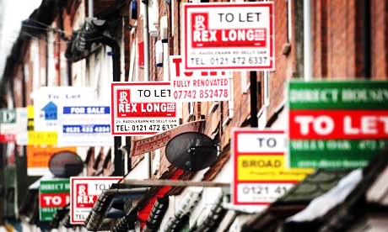
The changing geography of the private rented sector in England between 2001 and 2011
Nigel de Noronha
Doctoral Researcher, CCSR

Slide 2
Why does housing matter?
“Access to adequate housing has been a hallmark of the history of public policies in the United Kingdom. For generations, women and men have progressively given shape to the notion that a dignified life includes access to decent and fair housing, regardless of level of income or other status.” (p4-5)
“The Special Rapporteur considers that the United Kingdom faces a critical situation in terms of availability, affordability and access to adequate housing, particularly in some geographical areas.” (p7)
“For many, private tenancy is the only option.” (p9)
UN report, December 2013

Slide 3
Agenda
How has the private rented sector changed between 2001 and 2011 in England? Who has been affected by this change and where?
  The growth in the private rented sector
  Changing household types
  Stories of change
  A case in point – a tale of two cities

Slide 4
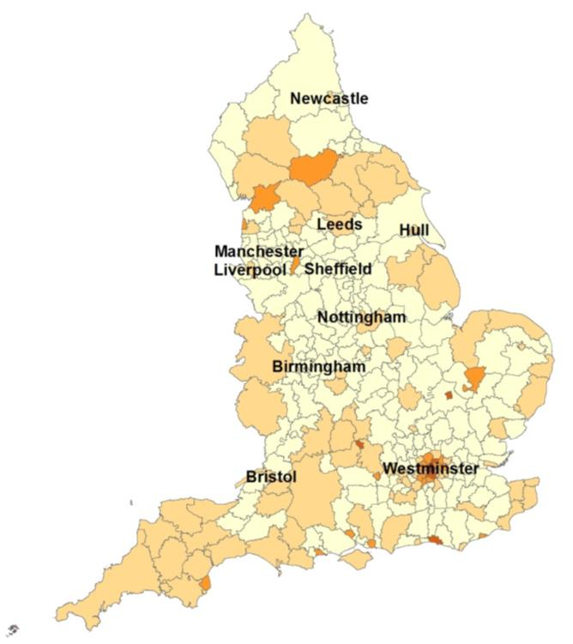
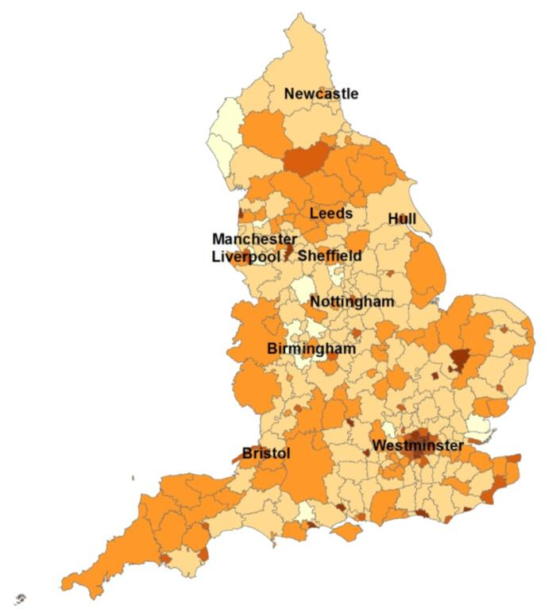
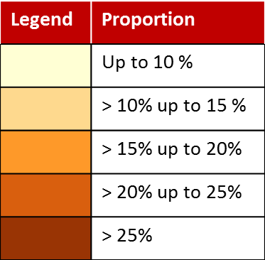
The private rented sector has grown …
2001 – England
2011 – England

Slide 5
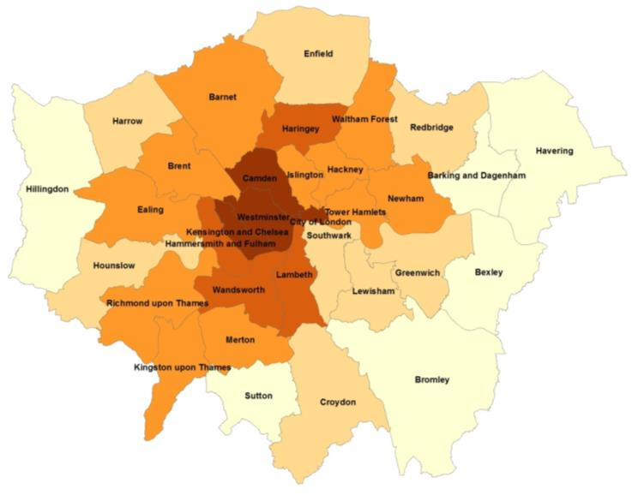
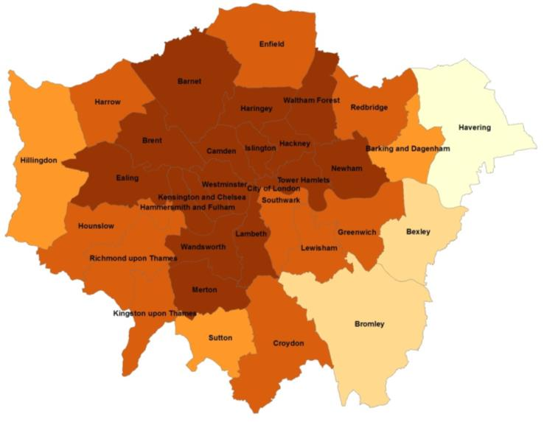
… in England …
2001 – London
2011 – London

Slide 6
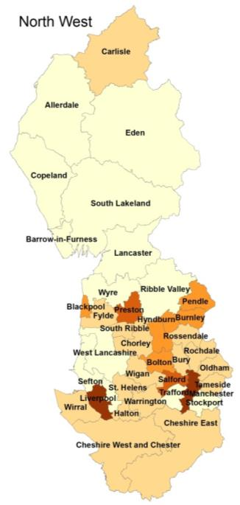
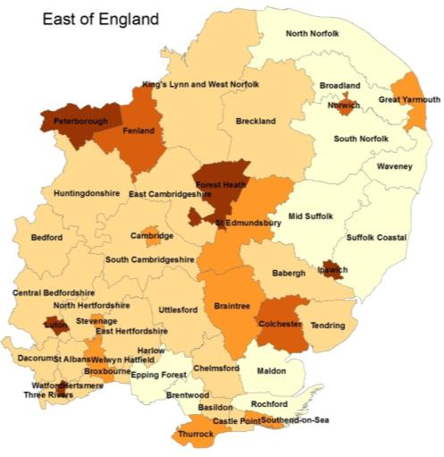
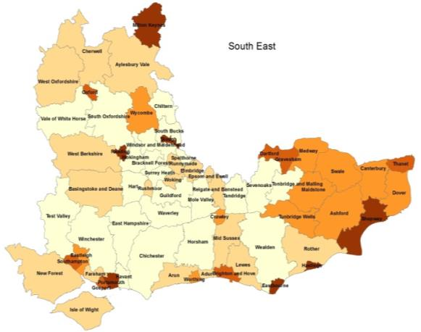
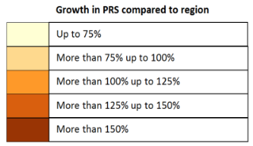
… but the growth is unevenly distributed …

Slide 7
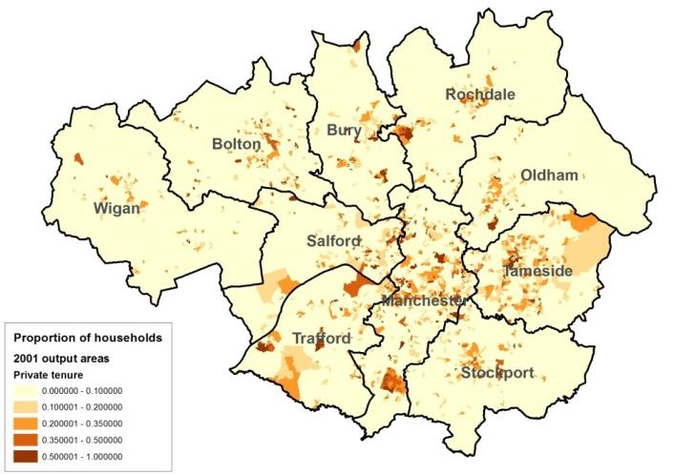
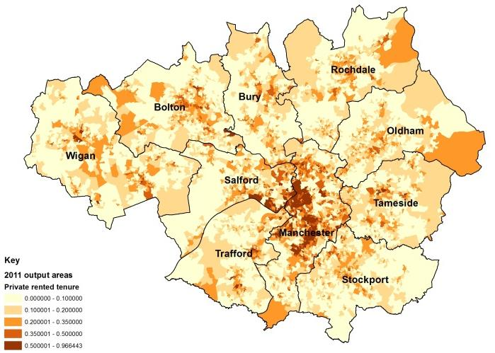
… at neighbourhood as well as district level

Slide 8
Household types are changing
Households ('000s) | 2001 |  |  |  |  | 2011
Region | Households without dependents | Older people | Dependent children | Non dependent children | All | Households without dependents | Older people | Dependent children | Non dependent children | All
England | 7,672 (38%) | 4,848 (24%) | 6,022 (29%) | 1,907 (9%) | 20,450 | ⬆8,953 (41%) | 4,576 (21%) | 6,423 (29%) | ⬆2,109 (10%) | 22,063
London | 1,326 (44%) | 555 (18%) | 872 (29%) | 261 (9%) | 3,015 | ⬆1,499 (46%) | ⬇454 (14%) | ⬆1,009 (31%) | ⬆302 (9%) | 3,266
South East | 1,230 (37%) | 807 (25%) | 959 (29%) | 289 (9%) | 3,287 | ⬆1,408 (40%) | 779 (22%) | ⬆1,044 (29%) | ⬆322 (9%) | 3,555
East | 820 (37%) | 551 (25%) | 653 (29%) | 205 (9%) | 2,231 | ⬆938 (39%) | 540 (22%) | ⬆712 (29%) | ⬆231 (10%) | 2,423
East Midlands | 644 (37%) | 414 (24%) | 513 (30%) | 160 (9%) | 1,732 | ⬆765 (40%) | 407 (21%) | 544 (29%) | ⬆178 (9%) | 1,895
West Midlands | 757 (35%) | 512 (24%) | 661 (31%) | 221 (10%) | 2,153 | ⬆868 (38%) | 492 (21%) | 692 (30%) | 240 (10%) | 2,294
South West | 778 (37%) | 564 (27%) | 569 (27%) | 173 (8%) | 2,085 | ⬆921 (41%) | 550 (24%) | 598 (26%) | ⬆193 (9%) | 2,264
North East | 369 (35%) | 265 (25%) | 317 (30%) | 113 (11%) | 1,066 | ⬆447 (40%) | 247 (22%) | 314 (28%) | 119 (11%) | 1,129
North West | 993 (35%) | 673 (24%) | 856 (30%) | 289 (10%) | 2,812 | ⬆1,199 (40%) | ⬇629 (21%) | 867 (29%) | 313 (10%) | 3,009
Yorkshire and Humberside | 751 (36%) | 503 (24%) | 617 (30%) | 192 (9%) | 2,064 | ⬆904 (41%) | 473 (21%) | 639 (29%) | 206 (9%) | 2,224

Slide 9
So what type of households now live in the PRS? How has this changed over time?
Household type | 2001 | 2011 | Change
Single person households | 673,117 | 1,083,074 | 409,957 (61%)
Couple with no children | 395,950 | 675,659 | 279,709 (71%)
Student households | 69,087 | 113,390 | 44,303 (64%)
Other households | 236,537 | 426,334 | 189,797 (80%)
Single pensioner | 303,974 | 233,839 | -70,135 (-23%)
Couple pensioner | 78,149 | 67,195 | -10,954 (-14%)
Other pensioner | 6,224 | 4,884 | -1,340 (-22%)
Couple with dependent children | 302,305 | 661,706 | 359,401 (119%)
Lone parent with dependent children | 251,517 | 469,585 | 218,068 (87%)
Other household with dependent children | 50,373 | 130,017 | 79,644 (158%)
Couple with no dependent children | 46,810 | 66,445 | 19,635 (42%)
Lone parent no dependent children | 42,347 | 78,906 | 36,559 (86%)

Slide 10
Some stories of change (1)
Households of single people under 65 have increased in most regions and as a group they are increasingly reliant on the private rented sector. Coastal areas, three central London boroughs and Forest Heath, site of two US Air Force bases show the largest increases in reliance on the PRS for this group.
Single people under 65
Area | Proportion of all households |  |  | Proportion living in the PRS |  |  | More than 35% in PRS in 2011
 | 2001 |  | 2011 | 2001 |  | 2011
England | 15.7% | ⬆ | 17.9% | 21.0% | ⬆ | 27.5%
London | 22.0% |  | 22.0% | 21.7% | ⬆ | 29.6% | Camden, Kensington and Chelsea, Westminster
South East | 14.1% | ⬆ | 16.1% | 22.7% | ⬆ | 28.0% | Brighton and Hove, Eastbourne, Hastings, Oxford, Shepway, Thanet, Worthing
East | 14.1% | ⬆ | 15.8% | 20.5% | ⬆ | 26.2% | Forest Heath
South West | 14.2% | ⬆ | 16.5% | 26.0% | ⬆ | 30.9% | Bournemouth, Torbay, Torridge
East Midlands | 14.3% | ⬆ | 16.7% | 19.2% | ⬆ | 25.9%
West Midlands | 14.5% | ⬆ | 16.9% | 17.8% | ⬆ | 24.6%
North East | 15.1% | ⬆ | 18.4% | 16.4% | ⬆ | 23.2%
North West | 15.9% | ⬆ | 19.4% | 19.5% | ⬆ | 26.8% | Blackpool, Burnley, Fylde, Liverpool
Yorkshire and Humberside | 14.7% | ⬆ | 17.9% | 21.5% | ⬆ | 28.2% | Scarborough

Slide 11
Some stories of change (2)
Couples without children have become increasingly reliant on the private rented sector. The growth has been particularly high in some inner London boroughs and South East and Eastern districts. Bristol, Bournemouth and Manchester have also experienced the increasingly reliance of these households on the PRS.
Couples without children
Area | Proportion of all households |  | Proportion living in the PRS |  |  | Districts where more than 25% of couples without children live in the PRS in 2011 (more than 40% in London)
 | 2001 | 2011 | 2001 |  | 2011
England | 17.8% | 17.6% | 10.9% | ⬆ | 17.4%
London | 13.8% | 13.8% | 22.2% | ⬆ | 32.6% | Camden, Hackney, Hammersmith and Fulham, Haringey, Islington, Kensington and Chelsea, Lambeth, Tower Hamlets, Wandsworth, Westminster
South East | 19.3% | 18.7% | 11.8% | ⬆ | 17.3% | Brighton and Hove, Hastings, Oxford, Portsmouth, Reading, Slough, Southampton
East | 19.5% | 19.0% | 10.1% | ⬆ | 15.6% | Cambridge, Forest Heath, Norwich
South West | 19.5% | 19.7% | 12.2% | ⬆ | 17.7% | Bournemouth, Bristol
East Midlands | 19.7% | 19.5% | 8.2% | ⬆ | 14.0%
West Midlands | 17.5% | 16.9% | 7.7% | ⬆ | 14.1%
North East | 16.9% | 17.7% | 6.2% | ⬆ | 12.3%
North West | 16.4% | 16.5% | 7.7% | ⬆ | 14.4% | Manchester
Yorkshire and Humberside | 18.5% | 18.7% | 10.9% | ⬆ | 14.8%

Slide 12
Some stories of change (3)
Other households have increased in most regions and as a group they are increasingly reliant on the private rented sector. The group is likely to be heterogeneous but one explanation might be affordability of accommodation for single people leading to shared households. Many of the areas where this is happening have major universities – perhaps a reflection of people staying around after studying.
Other households
Area | Proportion of all households |  |  | Proportion living in the PRS |  |  | More than 50% in PRS in 2011 (more than 65% in London)
 | 2001 |  | 2011 | 2001 |  | 2011
England | 3.7% | ⬆ | 4.5% | 31.6% | ⬆ | 42.8%
London | 7.7% | ⬆ | 9.4% | 44.5% | ⬆ | 55.8% | Newham, Tower Hamlets, Wandsworth
South East | 3.7% |  | 4.2% | 29.7% | ⬆ | 37.7% | Brighton and Hove, Oxford, Reading and Southampton
East | 2.9% | ⬆ | 3.7% | 26.2% | ⬆ | 37.1% | Cambridge, Forest Heath, Norwich
South West | 3.3% | ⬆ | 4.0% | 28.0% | ⬆ | 37.7% | Bournemouth, Bristol, Cheltenham
East Midlands | 2.7% | ⬆ | 3.5% | 25.1% | ⬆ | 37.6% | Boston, Lincoln, Nottingham
West Midlands | 2.8% | ⬆ | 3.6% | 21.3% | ⬆ | 34.2%
North East | 2.3% |  | 2.8% | 20.2% | ⬆ | 34.2% | Newcastle upon Tyne
North West | 2.7% | ⬆ | 3.4% | 22.2% | ⬆ | 36.9% | Manchester, Salford
Yorkshire and Humberside | 2.6% | ⬆ | 3.4% | 26.6% | ⬆ | 39.2% | Leeds, York

Slide 13
Some stories of change (4)
Couples with dependent children are increasingly reliant on the private rented sector. This is particularly true in Kensington and Chelsea and Westminster in London, Forest Heath and Richmondshire which are the site of military bases, coastal towns of Hastings, Thanet, Bournemouth and Blackpool, as well as Slough.
Couples with dependent children
 | Proportion of all households |  |  | Proportion living in the PRS
Area | 2001 |  | 2011 | 2001 |  | 2011 | More than 25% in the PRS in 2011 (more than 35% in London)
England | 20.8% | ⬇ | 19.3% | 7.1% | ⬆ | 15.5%
London | 17.7% |  | 17.8% | 9.8% | ⬆ | 22.7% | Kensington and Chelsea, Westminster
South East | 22.1% | ⬇ | 21.0% | 7.8% | ⬆ | 15.8% | Hastings, Slough, Thanet
East | 22.3% | ⬇ | 21.0% | 7.2% | ⬆ | 14.3% | Forest Heath
South West | 20.2% | ⬇ | 18.6% | 9.1% | ⬆ | 17.1% | Bournemouth
East Midlands | 21.7% | ⬇ | 19.7% | 5.9% | ⬆ | 13.8%
West Midlands | 21.6% | ⬇ | 19.7% | 5.6% | ⬆ | 13.5%
North East | 20.5% | ⬇ | 17.9% | 5.3% | ⬆ | 11.7%
North West | 20.5% | ⬇ | 18.4% | 5.5% | ⬆ | 12.9% | Blackpool
Yorkshire and Humberside | 21.2% | ⬇ | 19.2% | 6.5% | ⬆ | 14.0% | Richmondshire

Slide 14
Some stories of change (5)
Lone parents with dependent children are more reliant on the private rented sector than couples with dependent children. This is particularly true for a number of coastal areas, parts of East Lancashire and some outer London borough.
Lone parents with dependent children
 | Proportion of all households |  | Proportion living in the PRS
Area | 2001 | 2011 | 2001 |  | 2011 | More than 40% in the PRS in 2011
England | 6.4% | 7.1% | 19.2% | ⬆ | 29.8%
London | 7.6% | 8.5% | 14.0% | ⬆ | 27.3% | Enfield, Harrow, Redbridge
South East | 5.2% | 6.1% | 19.9% | ⬆ | 30.9% | Eastbourne, Hastings, Isle of Wight, Shepway, Thanet
East | 5.3% | 6.2% | 18.3% | ⬆ | 27.9% | Castle Point, Southend-on-Sea, Tendring
South West | 5.4% | 5.9% | 23.7% | ⬆ | 32.7% | Bournemouth, North Devon, North Somerset, Torbay, Torridge
East Midlands | 6.1% | 6.7% | 18.5% | ⬆ | 29.4%
West Midlands | 6.7% | 7.5% | 18.0% | ⬆ | 28.4%
North East | 7.4% | 8.1% | 17.5% | ⬆ | 29.7% | Darlington
North West | 7.7% | 8.1% | 22.3% | ⬆ | 31.5% | Blackpool, Burnley, Fylde, Hyndburn, Pendle, Wirral, Wyre
Yorkshire and Humberside | 6.6% | 7.1% | 21.8% | ⬆ | 31.9% | Bradford, North East Lincolnshire, Richmondshire, Scarborough

Slide 15
A tale of two cities
 | Manchester |  |  | Liverpool
 | 2001 | 2011 | Change | 2001 | 2011 | Change
Households | 167,451 | 204,969 | 22% | 187,865 | 206,515 | 10%
PRS | 31,424 | 61,411 | 95% | 28,515 | 50,987 | 79%
Single people | 9,908 | 17,390 | 76% | 8,949 | 20,951 | 134%
Other | 7,258 | 17,090 | 135% | 3,872 | 7,864 | 103%
Couples with dependent children | 2,152 | 6,950 | 223% | 1,790 | 4,143 | 131%
Single parents with dependent children | 3,356 | 5,121 | 53% | 5,280 | 7,028 | 33%
Source: 2001 and 2011 census

Slide 16
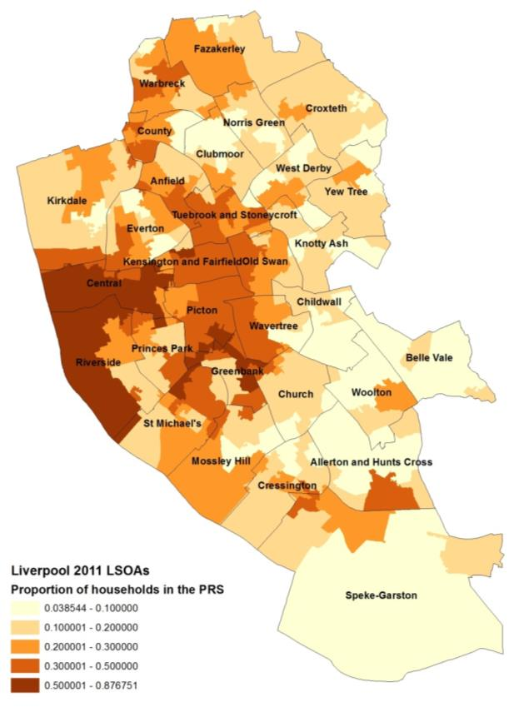
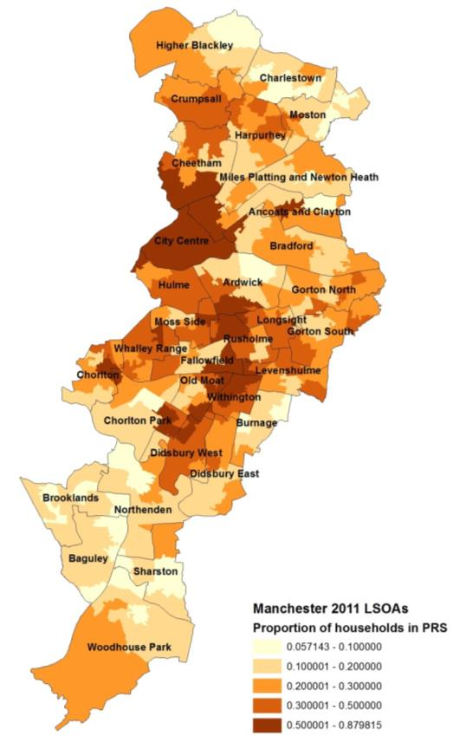
A tale of two cities

Slide 17
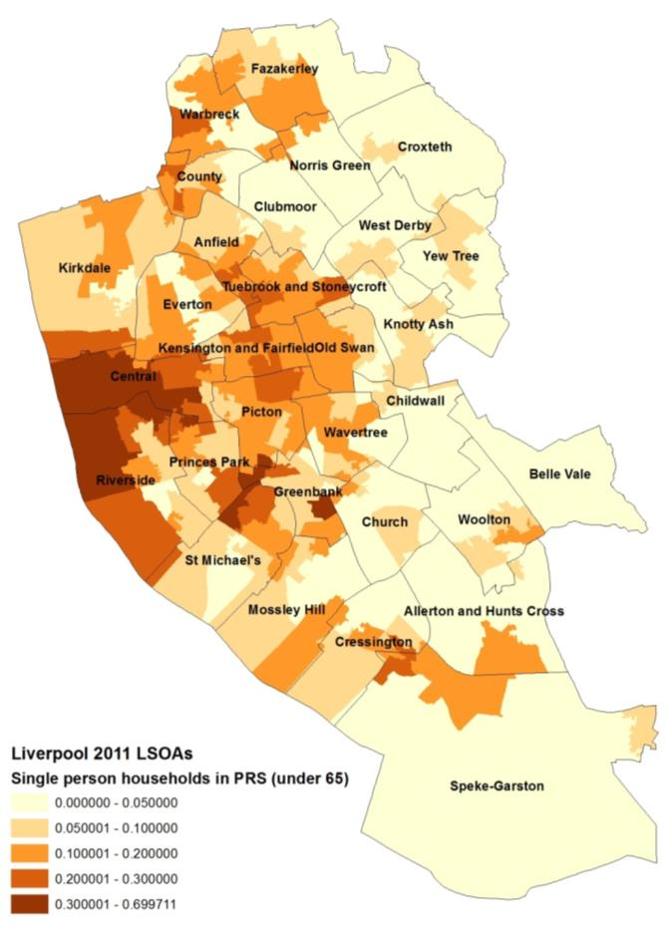
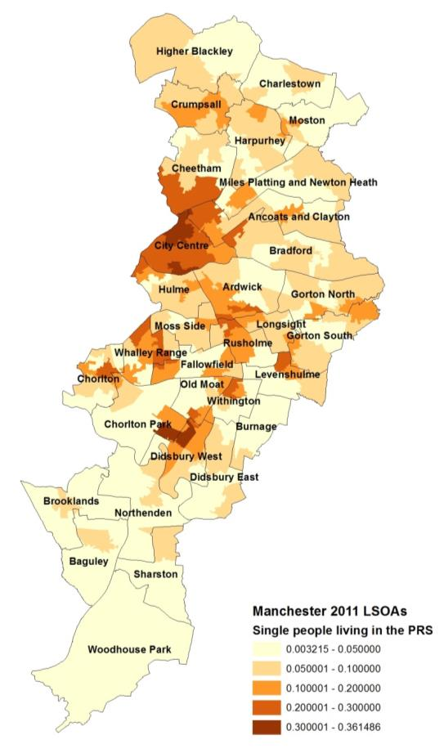
A tale of two cities

Slide 18
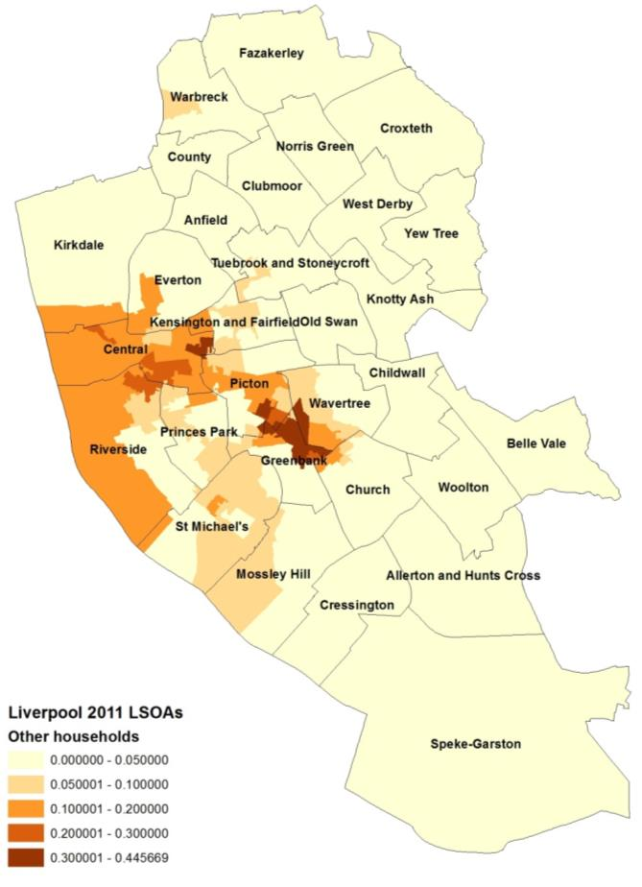
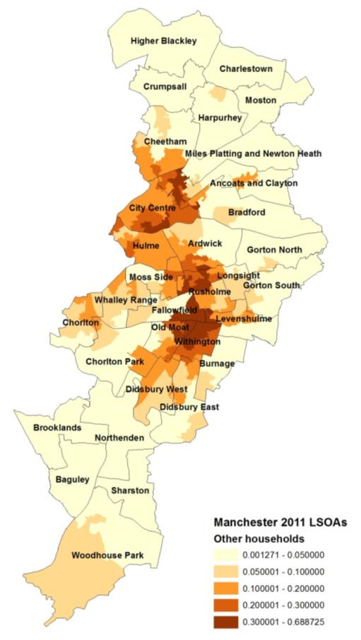
A tale of two cities

Slide 19
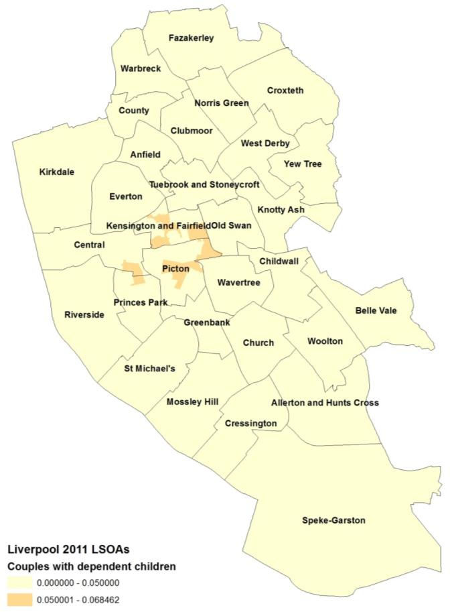
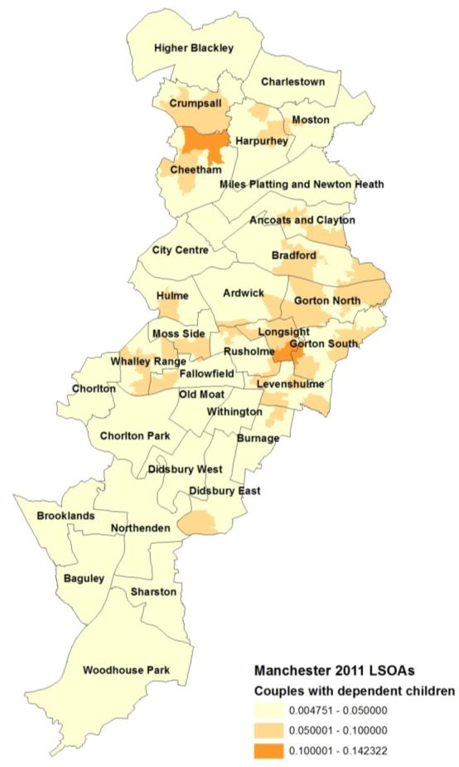
A tale of two cities

Slide 20
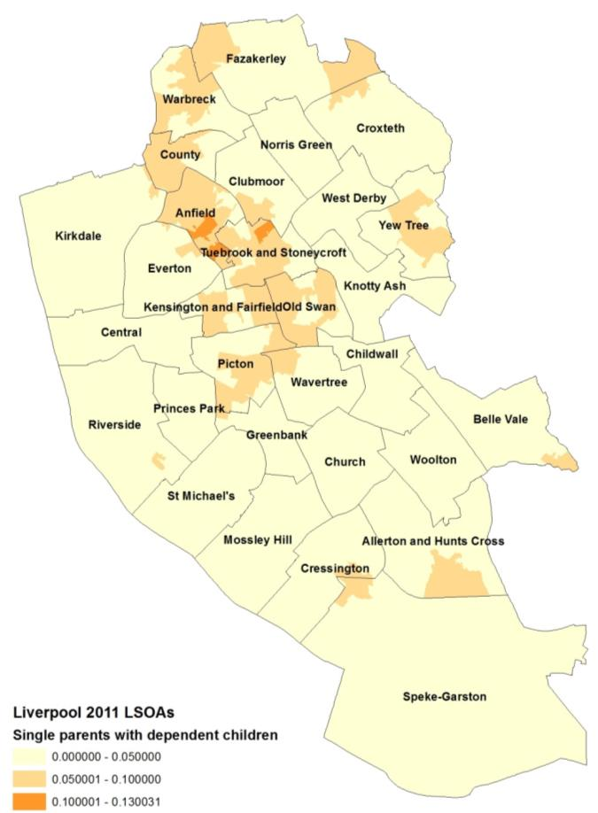
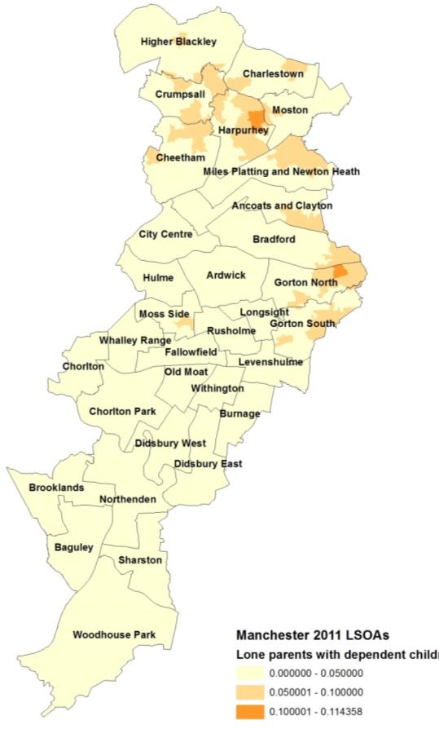
A tale of two cities

Slide 21
Conclusion
Growth of the private rented sector
Increasing reliance for some household types
  Single people (28%)
  Couples without children (17%)
  Other households (43%)
  Couples with dependent children (16%)
  Lone parents with dependent children (30%)
Spatial variation

